Slide 1




CV Workshop

Slide 2
Objectives
Know how to tailor your CV to a specific job or industry
Review how to structure a CV
Key considerations when looking at going to university
Brief overview of Post 18 options
One to one appointments with students and parents
One to one appointments with students and parents
Look at the different ways to gain a University education
Know how to structure a cover letter

Slide 3

CV Structure
What should be included and where?

Slide 4

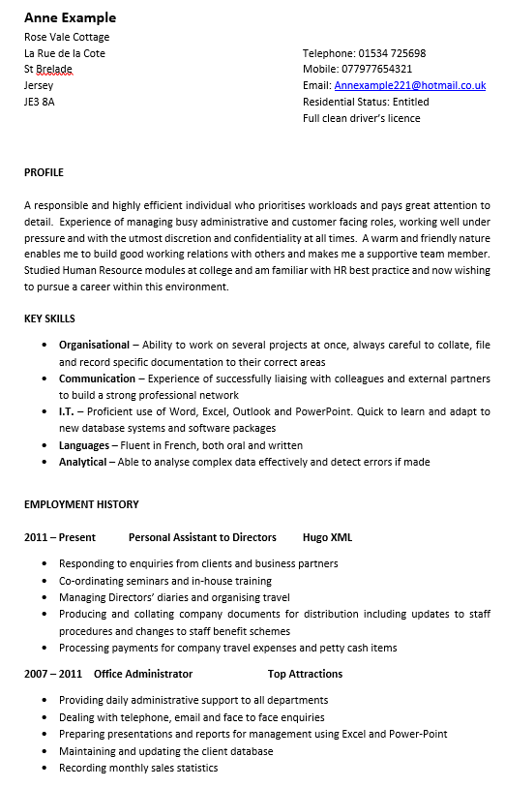
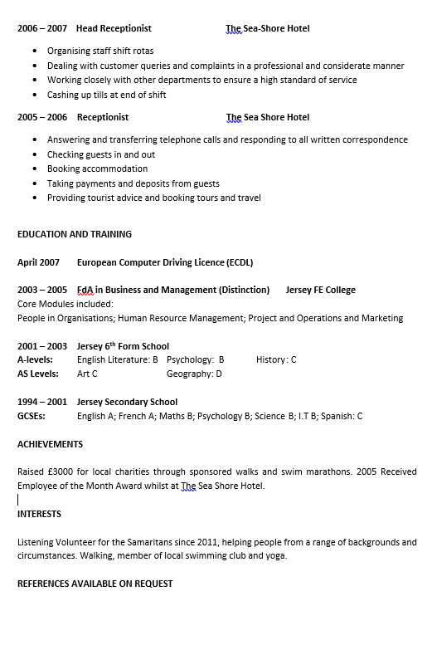
Adult example CV produced by:
Notes:
Go through each section - Why the information is important for each section
Top Tips –
Personal information – contact details only Professional e-mail
Personal profile – this is where you can sell yourself. A short statement to highlight your relevant skills and qualities to the area you are pursuing.
Key Skills - Make sure you give examples how you have developed these skills
Education – first if you are a school leaver with a brief work history. Always most recent first
Achievements – highlight any which demonstrate relevant skills
Work Experience – both paid and unpaid work should be included. Always start with most recent first
Hobbies – Only include current ones – explain skills developed if relevant to role
Gaps on your CV - Don’t try to conceal the gap but instead use it to show how you spent your time constructively and developed new qualities, skills or qualifications to bring to the workplace.

Slide 5
How to evidence your strengths:
Communication – will always take time to listen to the needs of others
Organisational – balanced part time work and university study
Creative – enjoy coming up with new ideas of how things can be improved
Skills
Communication
Analytical
Creative
Numerical
Customer Service
Problem Solving
Organisational
I.T
Languages
Money Management
Investigative
Leadership
Decision Making
Time Management

Slide 6
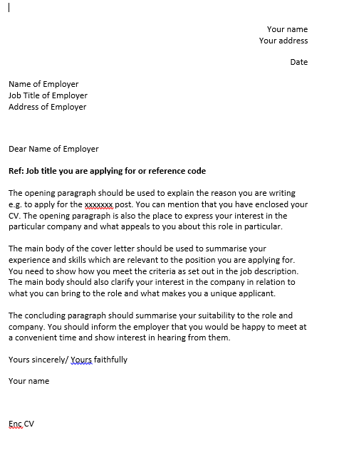

Cover Letter

Slide 7





449440
gov.je/skillsjersey
skillsjersey@gov.je
CONTACT US
skillsjersey
skills_jersey
Notes:
Contact us to have your CV reviewed or to book an appointment with a Careers Adviser

Slide 8




An Island wide Skills Service

