Slide 1
CV Workshop

Slide 2
Objectives
Know how to tailor your CV to a specific job or industry
Review how to structure a CV
Key considerations when looking at going to university
Brief overview of Post 18 options
One to one appointments with students and parents
One to one appointments with students and parents
Look at the different ways to gain a University education
Know how to structure a cover letter

Slide 3
CV Structure
What should be included and where?

Slide 4
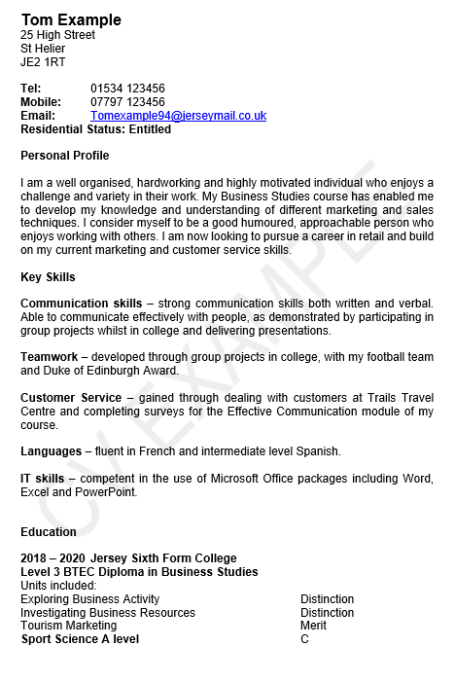
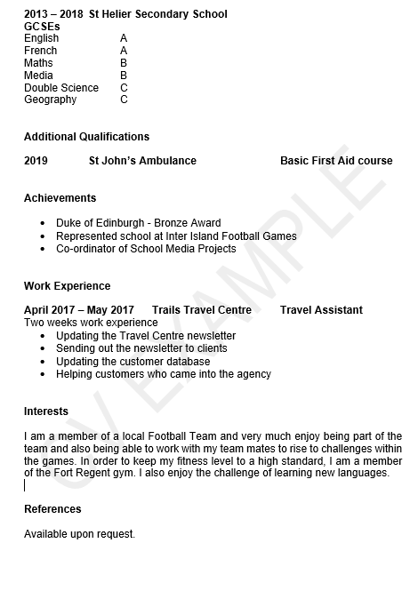
School leavers example CV produced by:

Slide 5
How to evidence your strengths:
Communication – will always take time to listen to the needs of others
Organisational – balanced part time work and university study
Creative – enjoy coming up with new ideas of how things can be improved
Skills
Communication
Analytical
Creative
Numerical
Customer Service
Problem Solving
Organisational
I.T
Languages
Money Management
Investigative
Leadership
Decision Making
Time Management

Slide 6
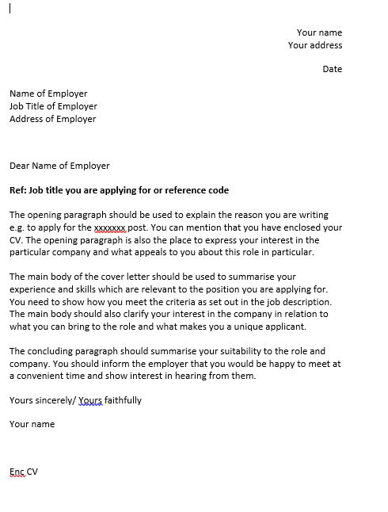
Cover Letter

Slide 7
449440
gov.je/skillsjersey
skillsjersey@gov.je
CONTACT US
skillsjersey
skills_jersey
Notes:
Contact us to have your CV reviewed or to book an appointment with a Careers Adviser

Slide 8
An Island wide Skills Service

