Slide 1
WELCOME TO
Industry

Slide 2
ARE YOU READY TO PLAY?

Slide 3
1
5
4
2
3
MEDICAL SERVICES
DID YOU GUESS IT??
GO!
GET READY TO COUNTDOWN FROM 5!
30 SECONDS TO GUESS THE INDUSTRY

Slide 4
Jobs within MEDICAL SERVICES
Doctor
Dentist
Paramedic
Can you name Three?
1. 2. 3.

Slide 5
1
5
4
2
3
DID YOU GUESS IT??
HOSPITALITY
GO!
GET READY TO COUNTDOWN FROM 5!

Slide 6
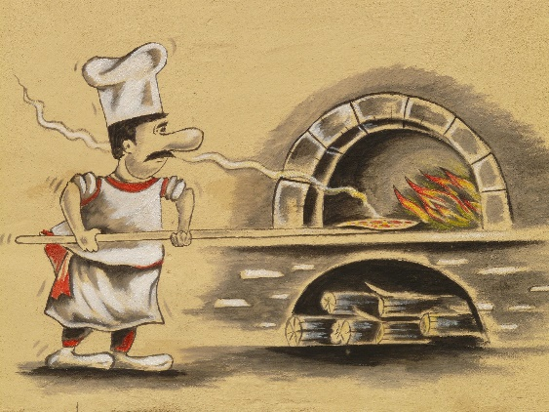
Jobs within HOSPITALITY
Chef
Waiter/Waitress
Event Planner
Can you name Three?
1. 2. 3.

Slide 7
1
5
4
2
3
CONSTRUCTION
DID YOU GUESS IT??
GO!
GET READY TO COUNTDOWN FROM 5!

Slide 8
Jobs within CONSTRUCTION
Plumber
Electrician
Carpenter
Can you name Three?
1. 2. 3.

Slide 9
1
5
4
2
3
LAW
DID YOU GUESS IT??
GO!
GET READY TO COUNTDOWN FROM 5!

Slide 10
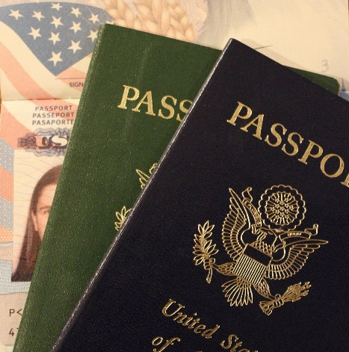
Jobs within LAW SERVICES
Detective
Inspector
Lawyer
Customs &
Immigration Officer
Can you name Three?
1. 2. 3.

Slide 11
1
5
4
2
3
DID YOU GUESS IT??
AGRICULTURE
GO!
GET READY TO COUNTDOWN FROM 5!

Slide 12
Jobs within AGRICULTURE
Gardener
Plant
Pathologist
Farmer
Can you name Three?
1. 2. 3.

Slide 13
1
5
4
2
3
DID YOU GUESS IT??
SPORT
GO!
GET READY TO COUNTDOWN FROM 5!

Slide 14
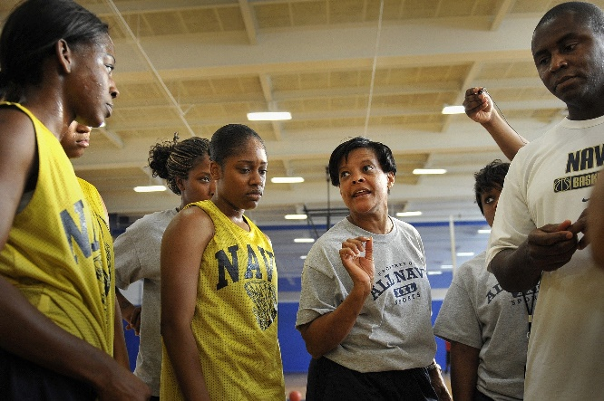
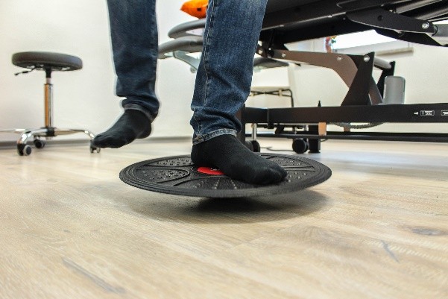
Jobs within SPORT
Coach
Physio
Sports Writer
Can you name Three?
1. 2. 3.

Slide 15
1
5
4
2
3
CARE SERVICES
DID YOU GUESS IT??
GO!
GET READY TO COUNTDOWN FROM 5!

Slide 16
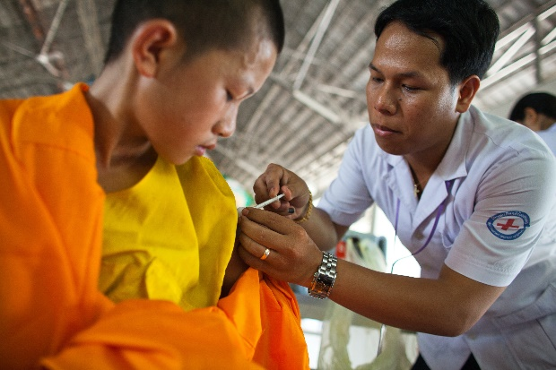
Jobs within CARE SERVICES
Nurse
Health Care
Assistant
Social Worker
Can you name Three?
1. 2. 3.

Slide 17
1
5
4
2
3
UNIFORM SERVICES
DID YOU GUESS IT??
GO!
GET READY TO COUNTDOWN FROM 5!

Slide 18
Jobs within UNIFORM SERVICES
WPC
RAF Pilot
Fireman
Can you name Three?
1. 2. 3.

Slide 19
1
5
4
2
3
DID YOU GUESS IT??
FINANCIAL SERVICES
GO!
GET READY TO COUNTDOWN FROM 5!

Slide 20
Jobs within FINANCIAL SERVICES
Accountant
Stockbroker
Bank Manager
Can you name Three?
1. 2. 3.

Slide 21
1
5
4
2
3
DID YOU GUESS IT??
DIGITAL
GO!
GET READY TO COUNTDOWN FROM 5!

Slide 22
Jobs within DIGITAL
App
Developer
Website
Designer
Photographer
Can you name Three?
1. 2. 3.

Slide 23
THANK
YOU FOR TAKING PART!

