Slide 1
2019 Roundup

Slide 2
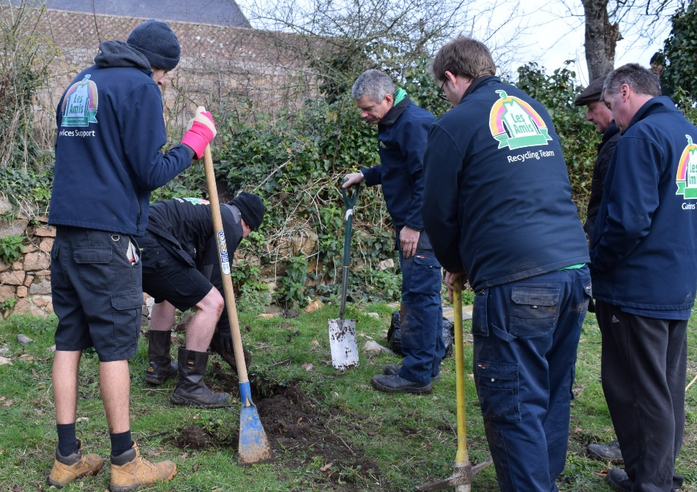
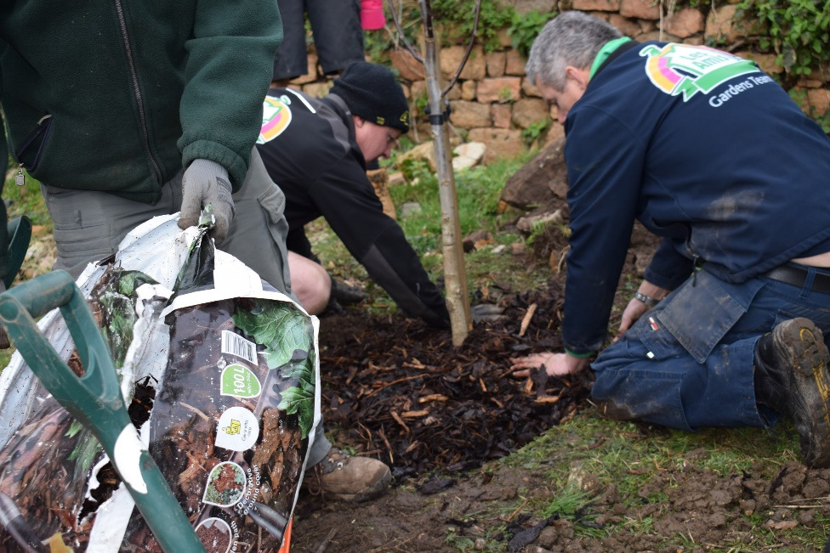
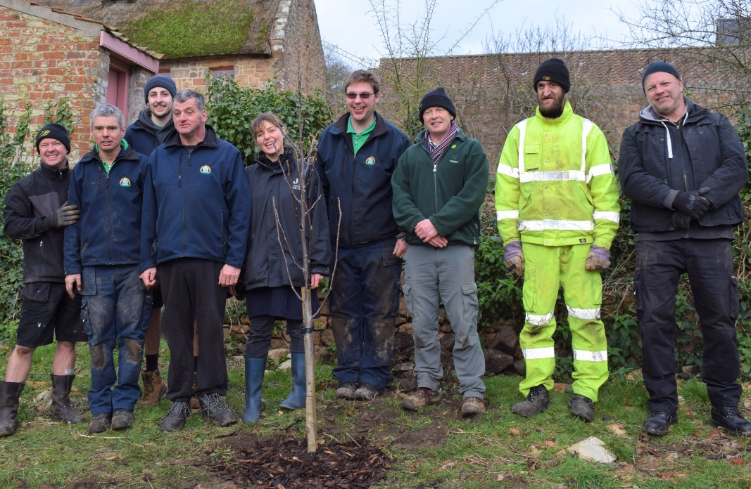
We started the year doing something we love, helping others out.
We were invited to help plant some trees at Hampton Country Life museum with Jersey Trees for Life

Slide 3
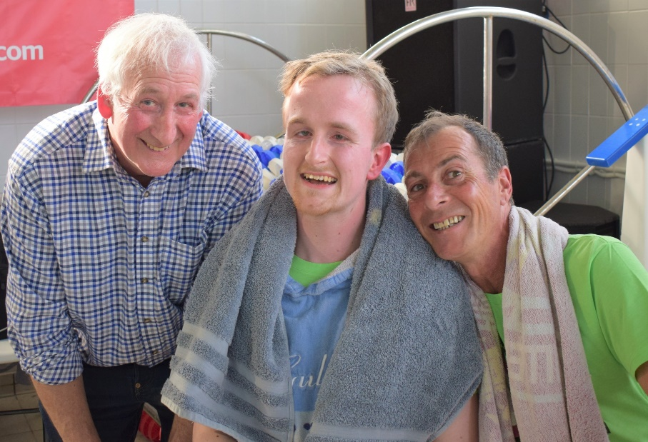
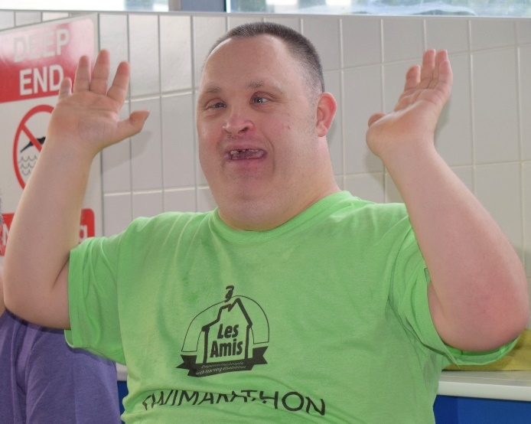
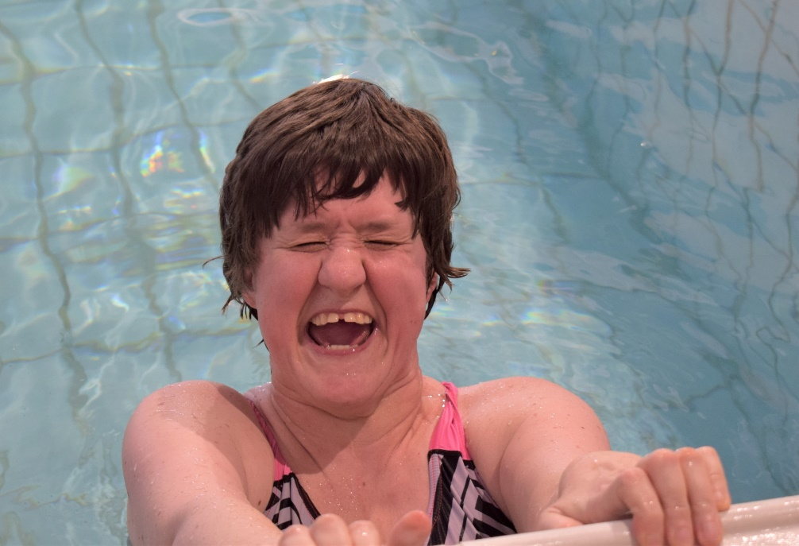
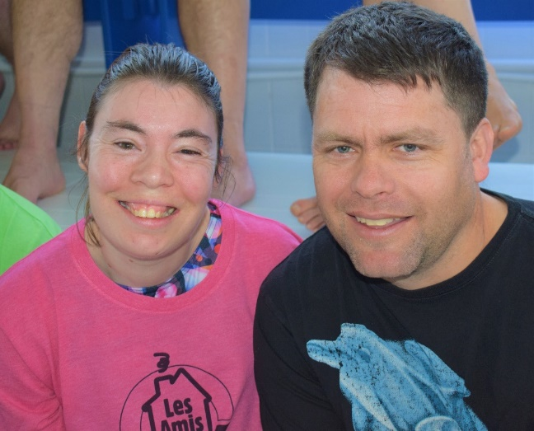
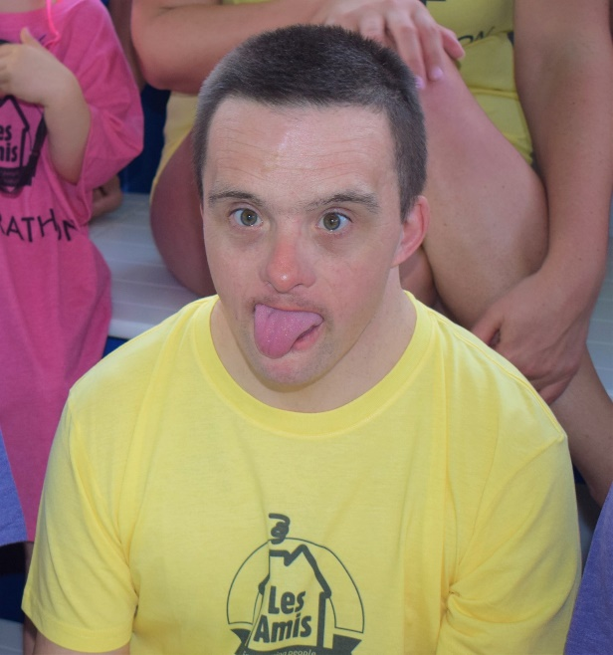
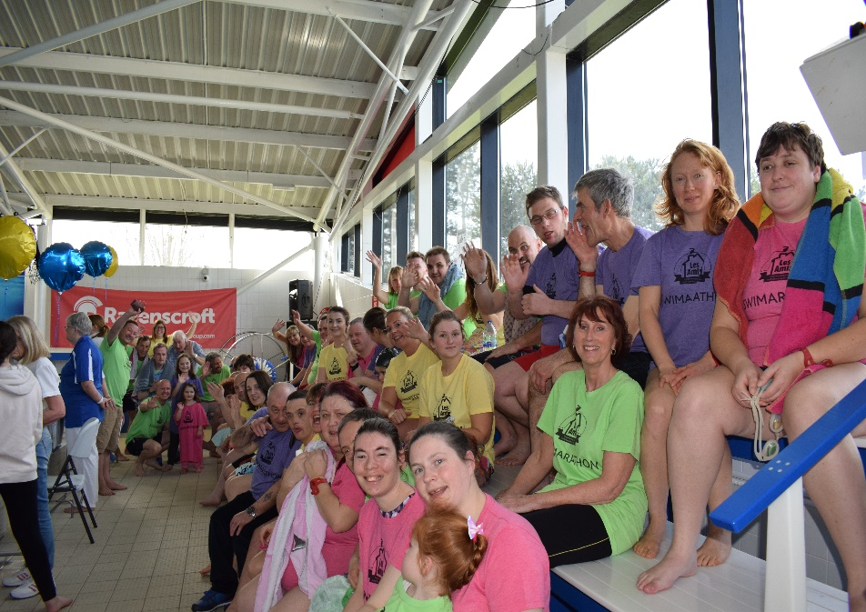
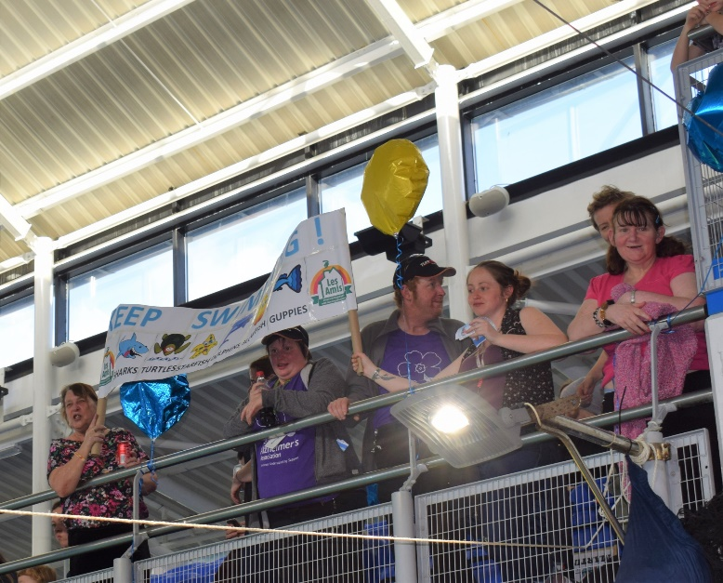
We took part in the swimarathon again.

Slide 4
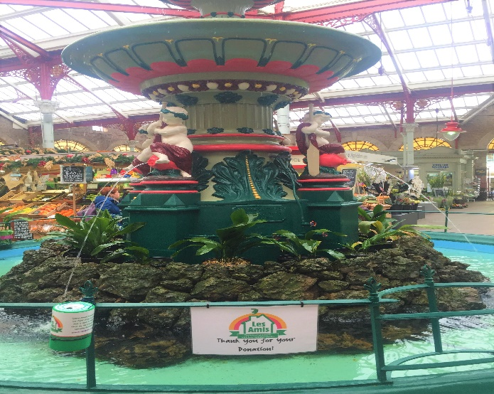
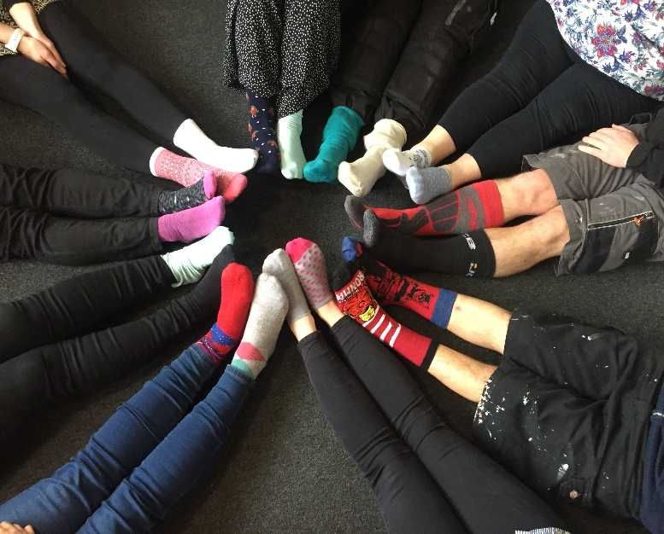
All wore our odd socks for Down Syndrome Awareness Day,
And hung our collection tins on the Central Market Fountain.

Slide 5
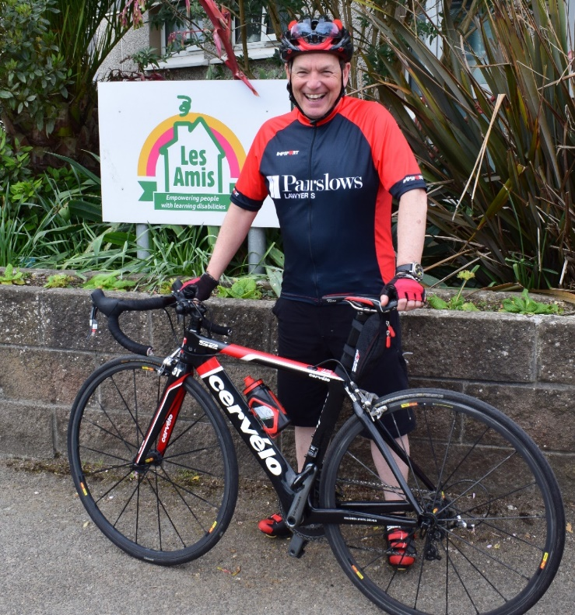
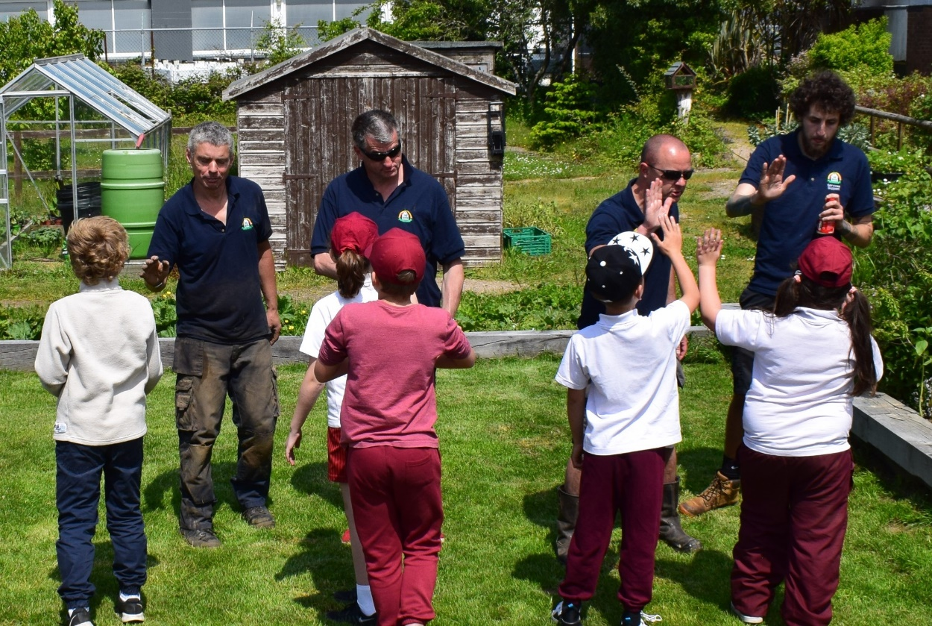
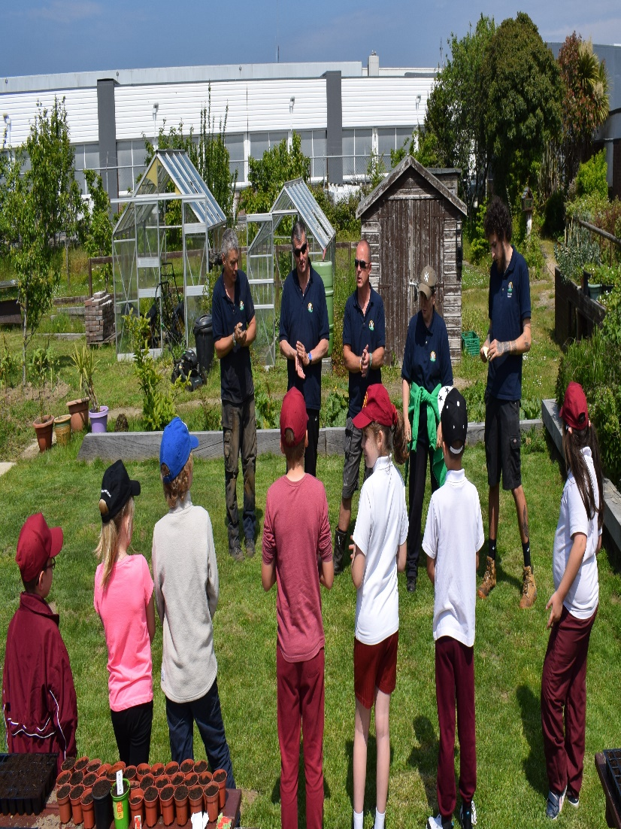
Then Eddie Cycled really far to raise money for us.
Thank you!
While the gardens team planted seeds and grew connections with students from
St Saviours School.

Slide 6
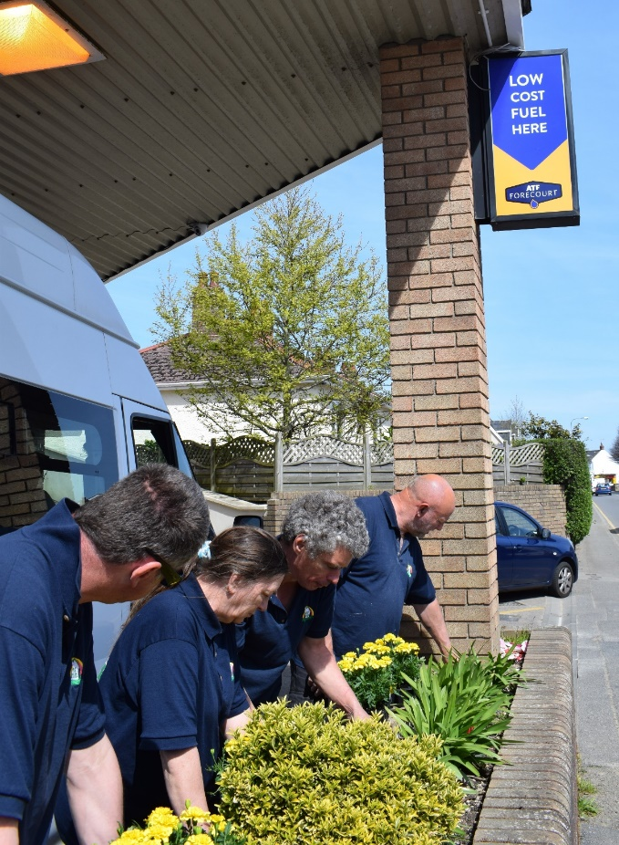
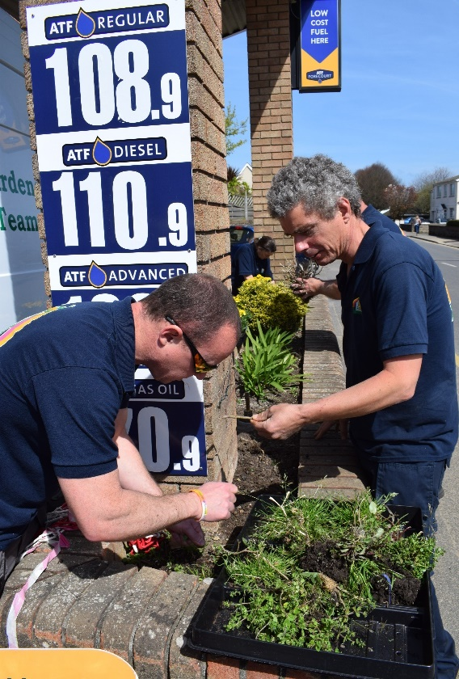
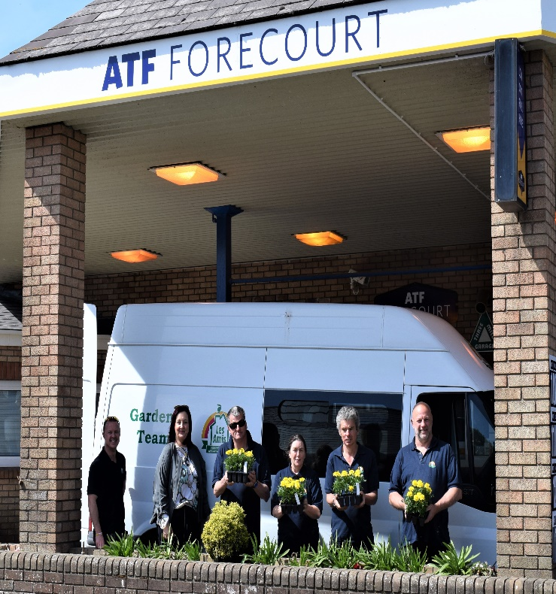
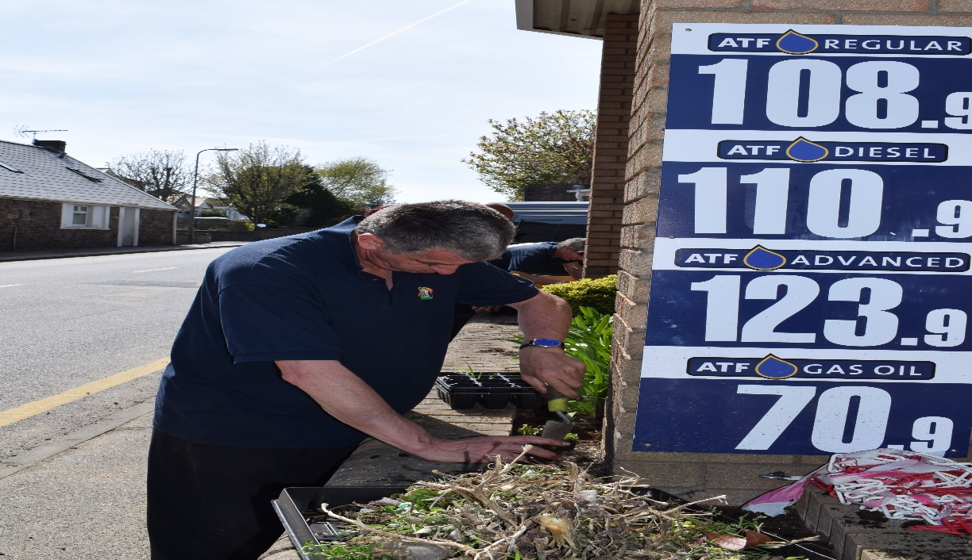
Before popping up the road and helping our new Corporate Partners, ATF Fuels, make their Maufant forecourt look fresh and floral.

Slide 7
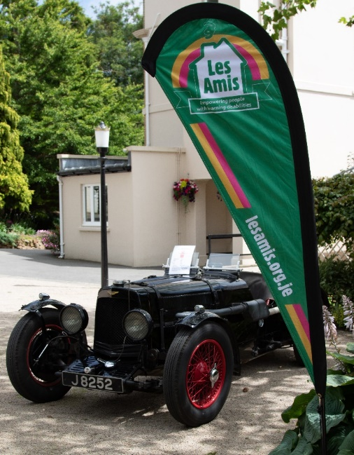
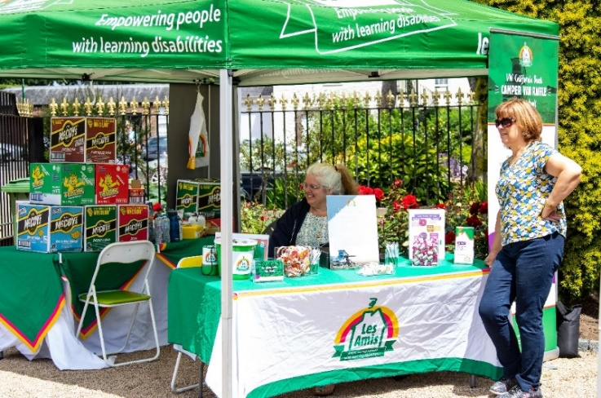
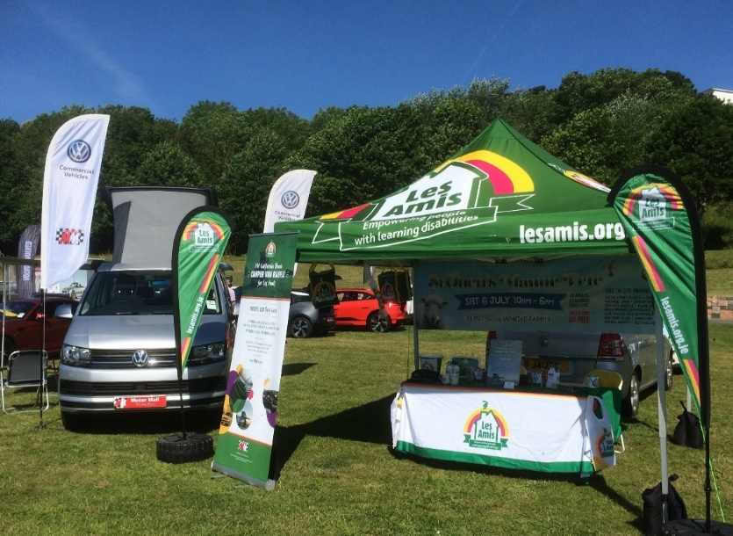
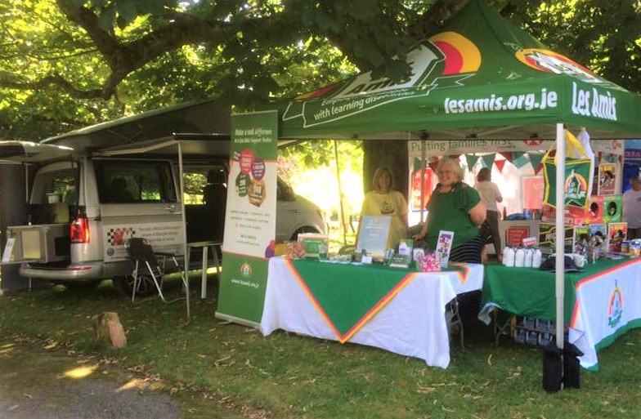
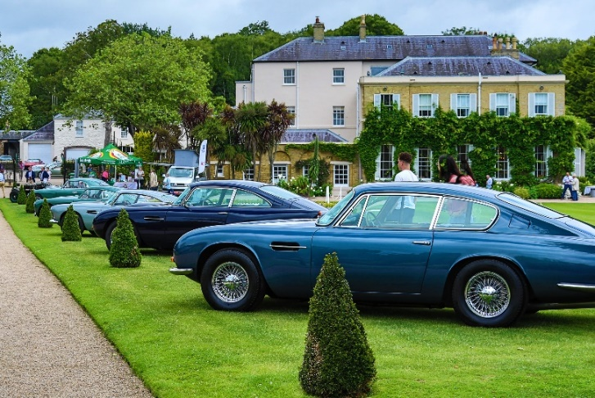
We launched another raffle to win a new VW Campervan.
Spent a lovely afternoon at Government House with some Aston Martins,
And had a beautiful day at St Ouen’s Manor Fete.

Slide 8
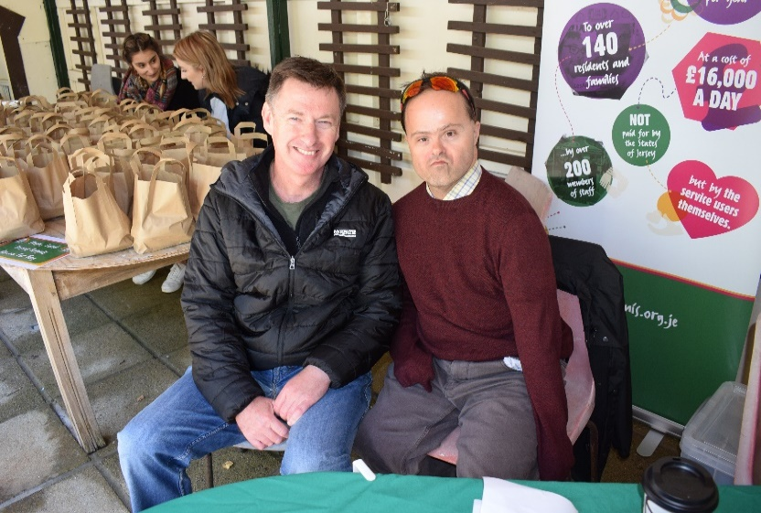
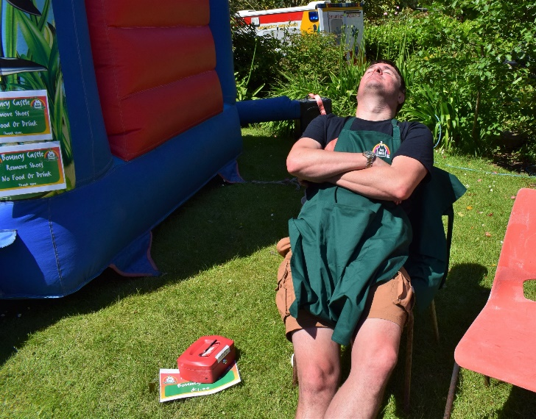
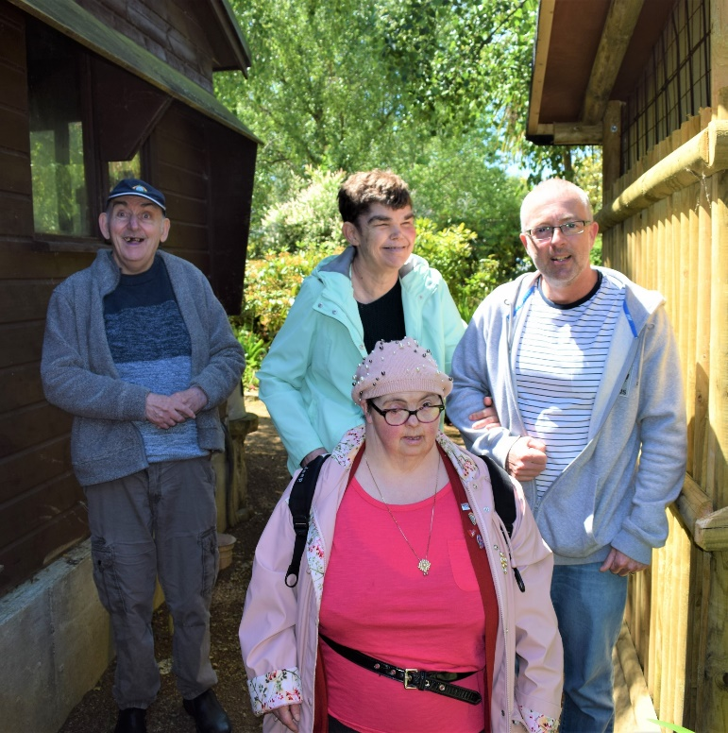
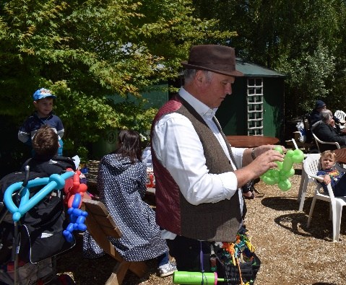
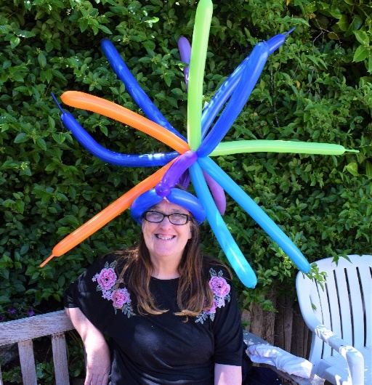
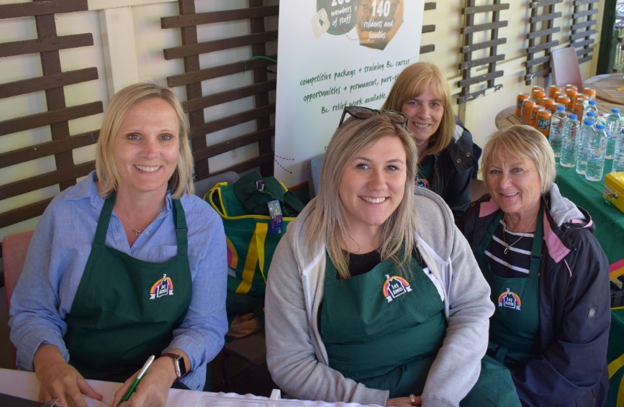
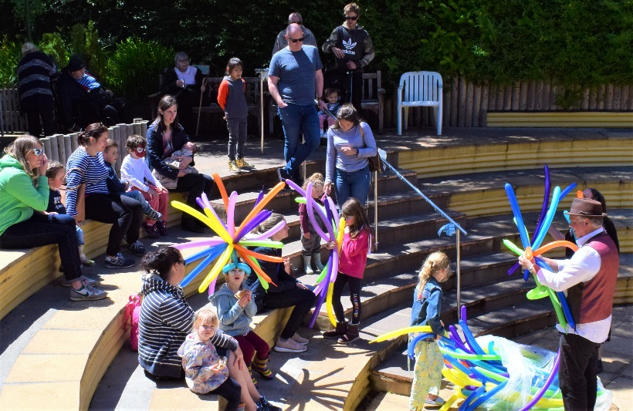
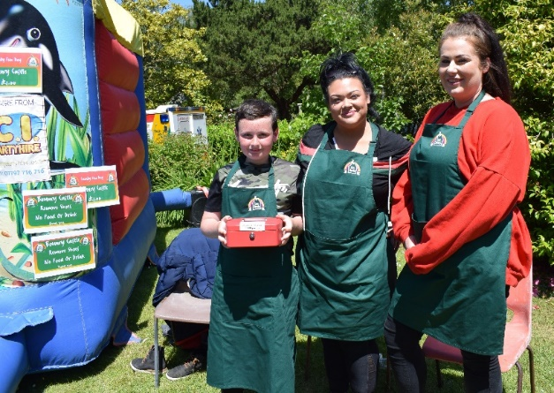
Family Fun Day was a little quieter this year, but just as much fun for everyone who attended.

Slide 9
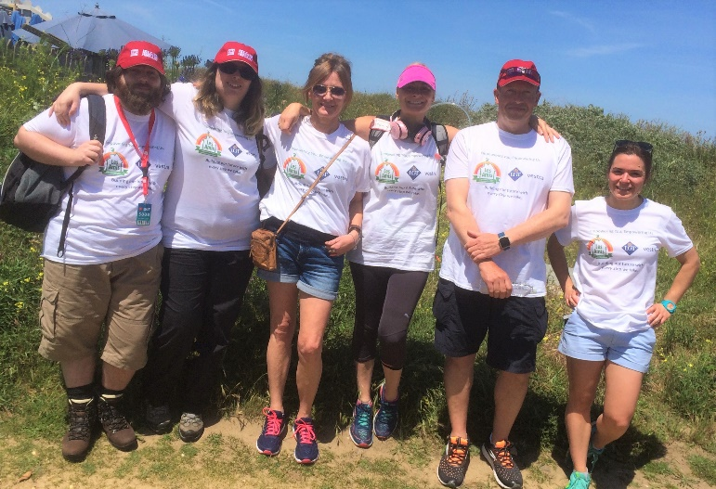
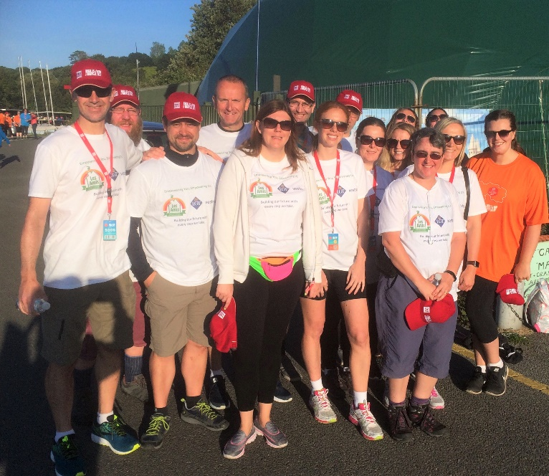
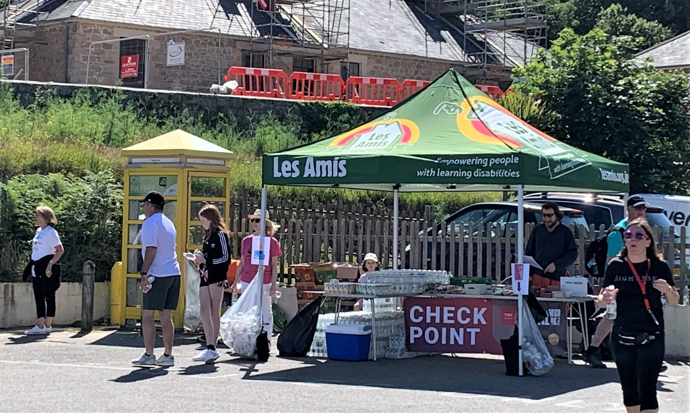
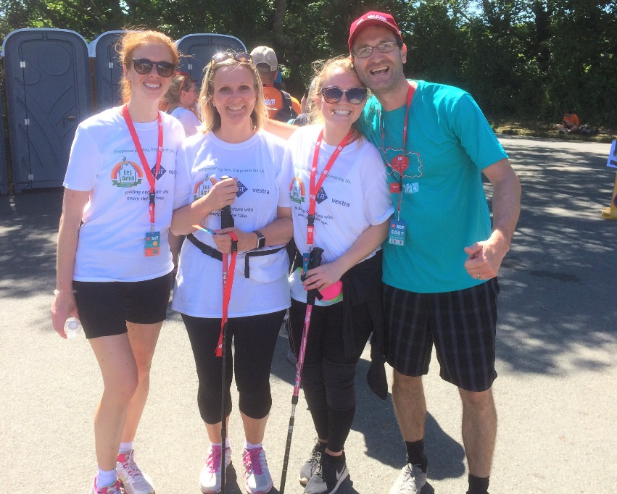
Once again we took part in and supported the walkers of the Island Walk.
This year we had 8 teams of staff from Les Amis and LGT Vestra walking together in the relay.
And ran the water station and checkpoint at Greve de Lecq

Slide 10
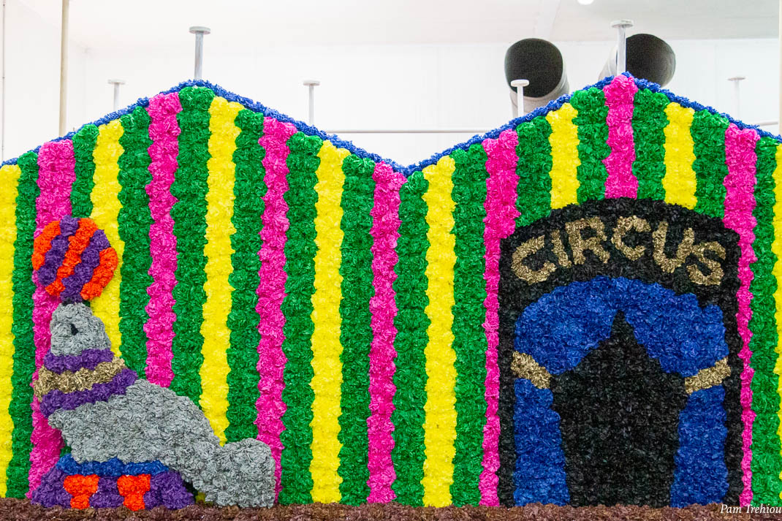
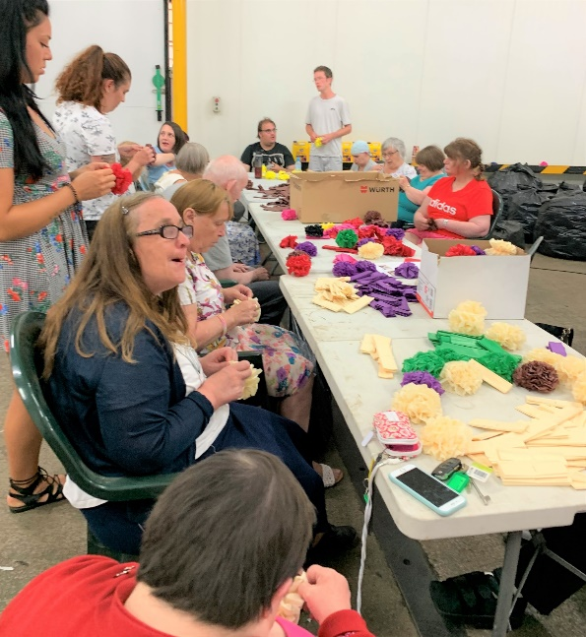
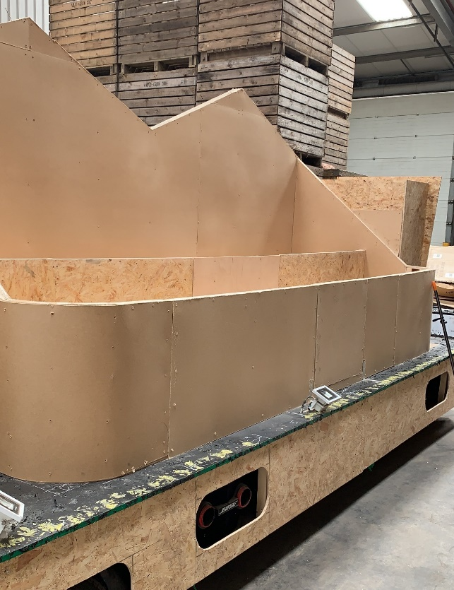
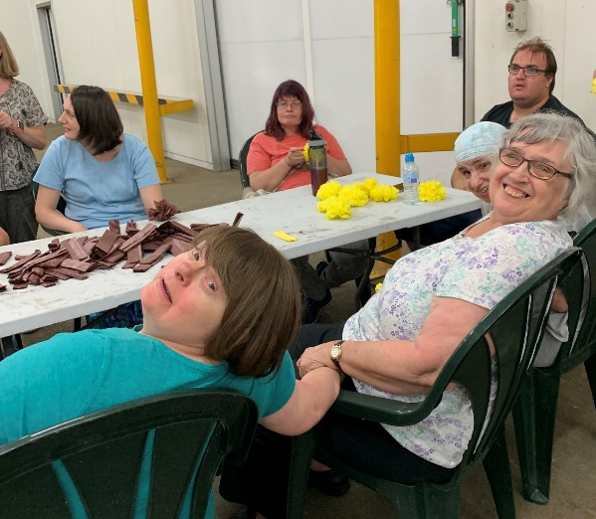
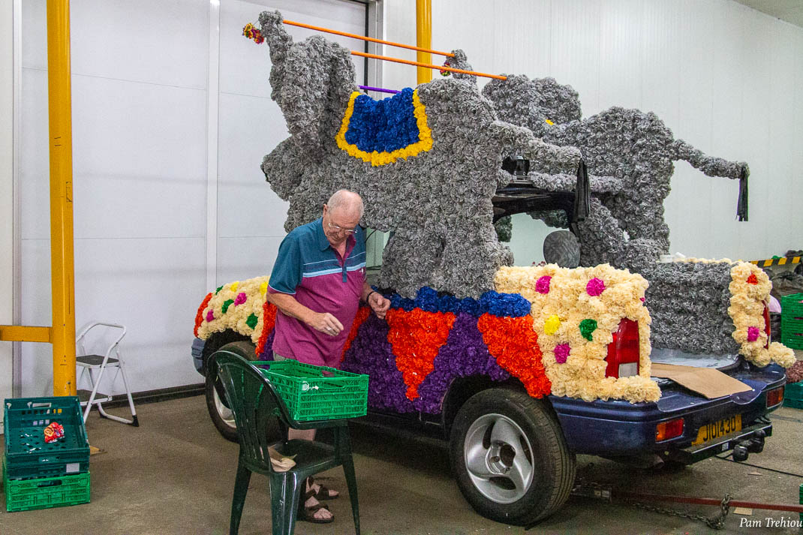
We worked our socks of and had loads of fun getting ready for Battle of Flowers this year,

Slide 11
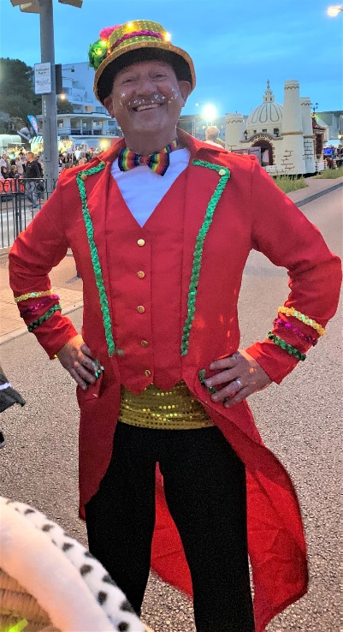
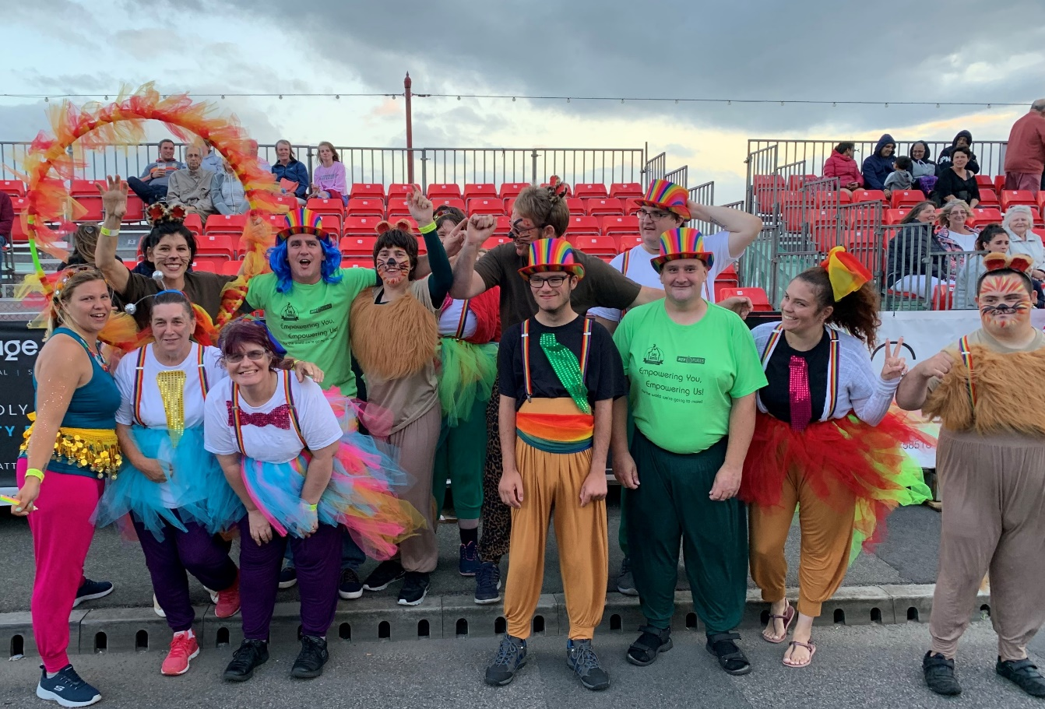
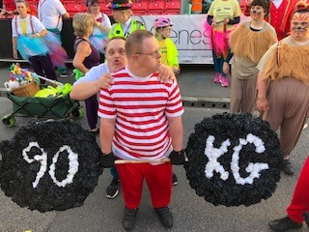
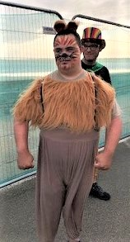
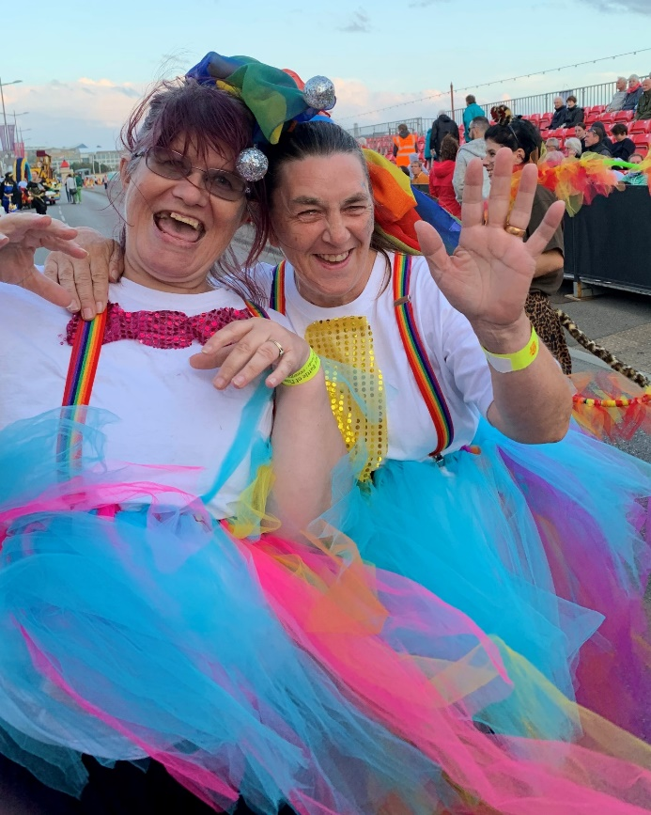
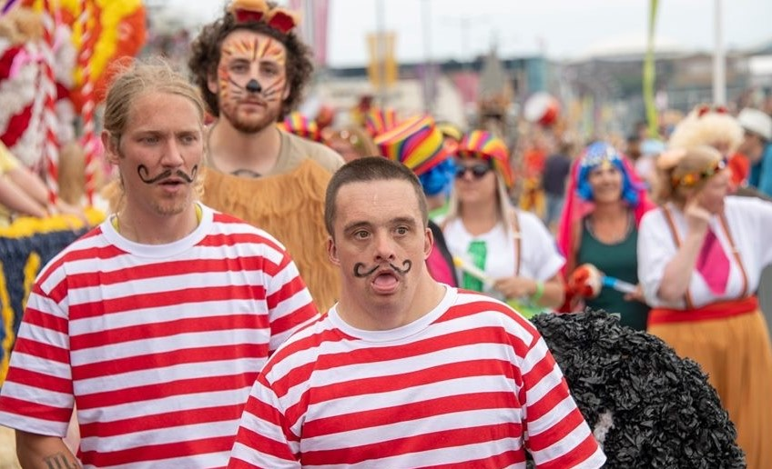
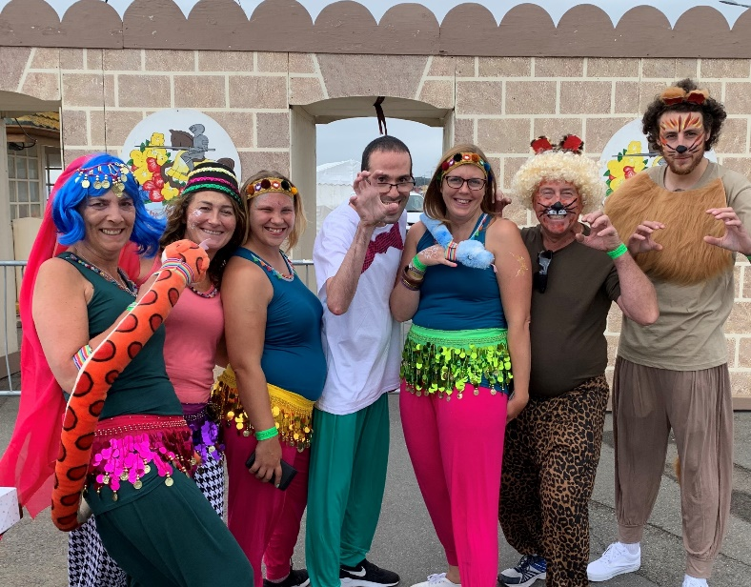
Then danced our way through both parades,

Slide 12
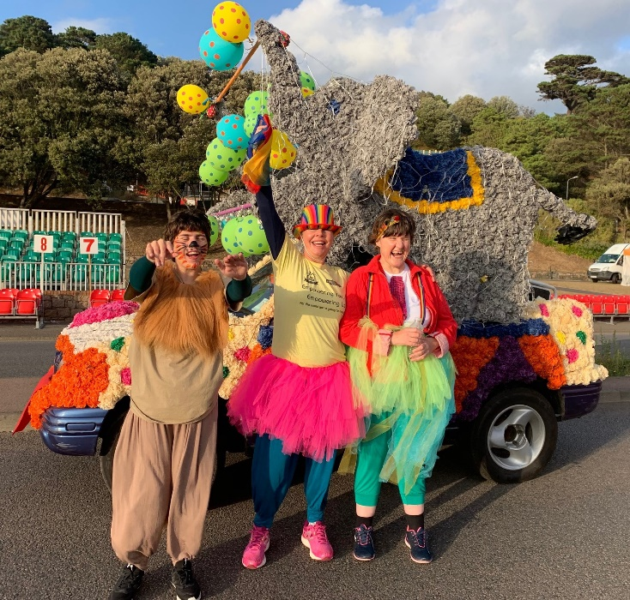
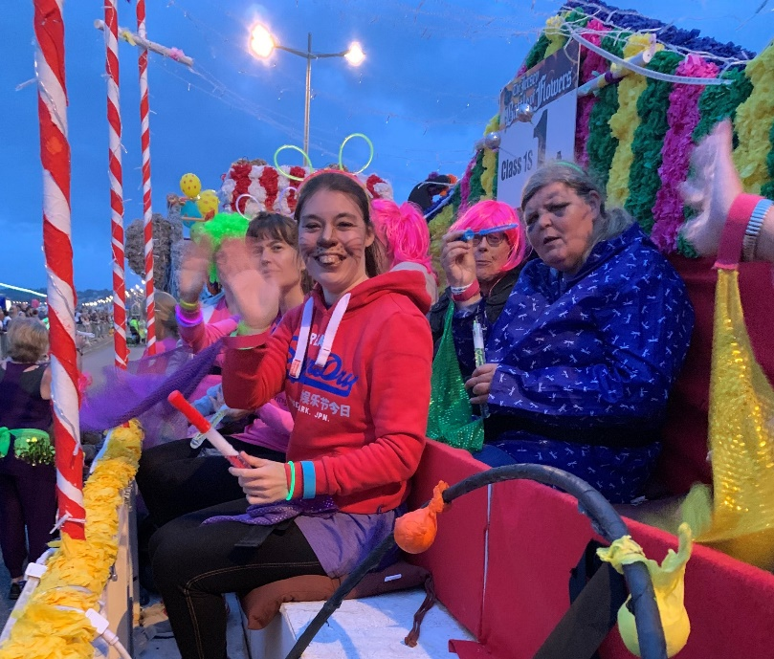
Winning FOUR awards in the process!

Slide 13
Then ended the summer with a BBQ at the West Hill Hotel

Slide 14
Next followed Flag week.
And the Annual Plankathon

Slide 15
Jim ran the Great North Run on behalf of Les Amis!
While Zoe, Vicki and Sharon ran the Disney half marathon!

Slide 16
Then to start getting into the festive spirit the choir sang at Mont a L’Abbe school Christmas Fair
And we helped our friends at ZEDRA to decorate the tree in their reception area

Slide 17
Looking back it has been a very busy year
We have worked alongside other local charities and local schools.
Lots of amazing people have fundraised on our behalf.
And through it all we have been a constant, smiling presence in our community showing everyone that here at Les Amis disability does not mean inability.

Slide 18
So we would all like to take this opportunity
To say a very big Thank You to everyone who has worked with us and supported us this year

