Slide 1
Les Amis
Jason Loveless
Head of Compliance

Slide 2
Jason Loveless
Head of Compliance
Les Amis 7 years
Previous work history
Customer Service
Notes:
Good afternoon everyone my name is Jason Loveless and I am the Head of Compliance at Les Amis.
Just to give you a bit of background...
I joined Les Amis 7 years ago as a support worker and gradually worked my way through DPM, PM, HoS then HoC during which time I completed CMI level 5.
Prior to Les Amis I worked for NSPCC and helped set up a family centre called Pathways in St Clements and started the first Dad’s Club in the island.
And prior to that I was a TA, dance and drama teacher and professional dancer!
I am also safeguarding lead for Les Amis and deliver our Adult and Children’s Safeguarding training as well as equality and inclusion training. Myself and one of my managers are currently designing new uatism training that will roll out across the organisation.
Good customer service is important to me. Although it can be simple it is not always easy to do! At Les Amis our customers are the residents and services users, they are at the heart of everything we do and of course in any business working in HR my customers will always be the staff too.
So enough about me…lets move on to Les Amis.

Slide 3
INTRODUCTION
Les Amis was first opened in 1975 and was originally known as Maison Variety. The Charity was developed to meet the needs of people with learning disabilities, in Jersey.
Les Amis has grown immensely over the years and currently supports around 140 residents who’s ages range from 14 to 80.
The individuals we support all have different levels of needs, some need a high level of support requiring 24/7 support, others are very independent and only require support with certain tasks such as cooking, shopping and budgeting.
Notes:
42 years old!
84 perm residents.

Slide 4
Vision
“To ensure people with learning disabilities and or associated conditions, reach their full potential in life”
Mission Statement
“To deliver and develop quality services, in partnerships, that support people with learning disabilities and or associated conditions to experience positive and equal opportunities in Jersey”

Slide 5
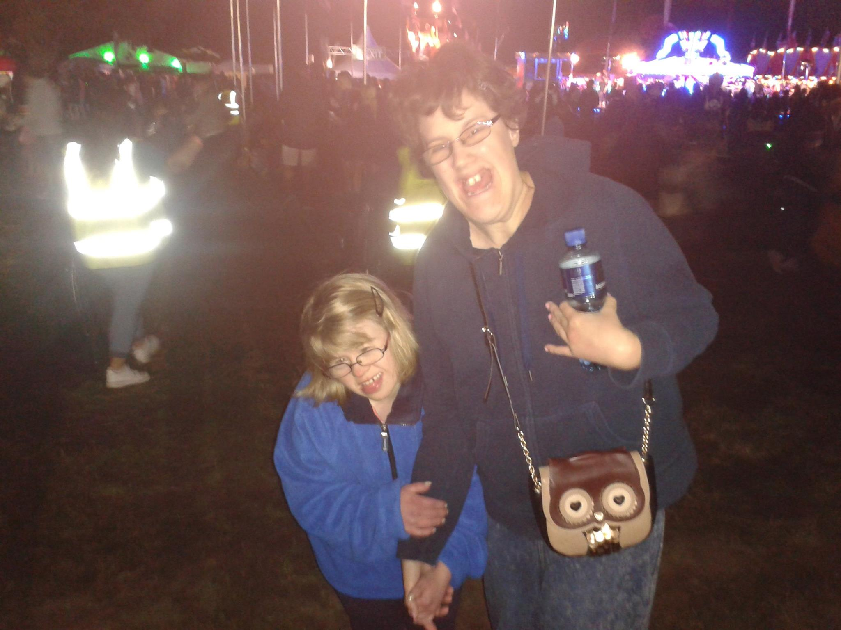
Support
Les Amis is about providing support for people with Learning Disabilities, by encouraging and assisting people to be as independent as possible.
Empowering
Promoting Independence
Normalisation
Skills development
Notes:
Discuss peoples own perception of being a support worker? Can you think of the difference between a support worker and a healthcare assistant or carer?
Care - end of life
Support – is all about living!
At Les Amis we have core values for our residents, service users and our staff. We call them the 5 accomplishments and these are extremely important to us in relation to the customer service we provide. We continuously aim to promote practice excellence and aim for personalisation for our residents and service users.
So the first accomplishment is…

Slide 6
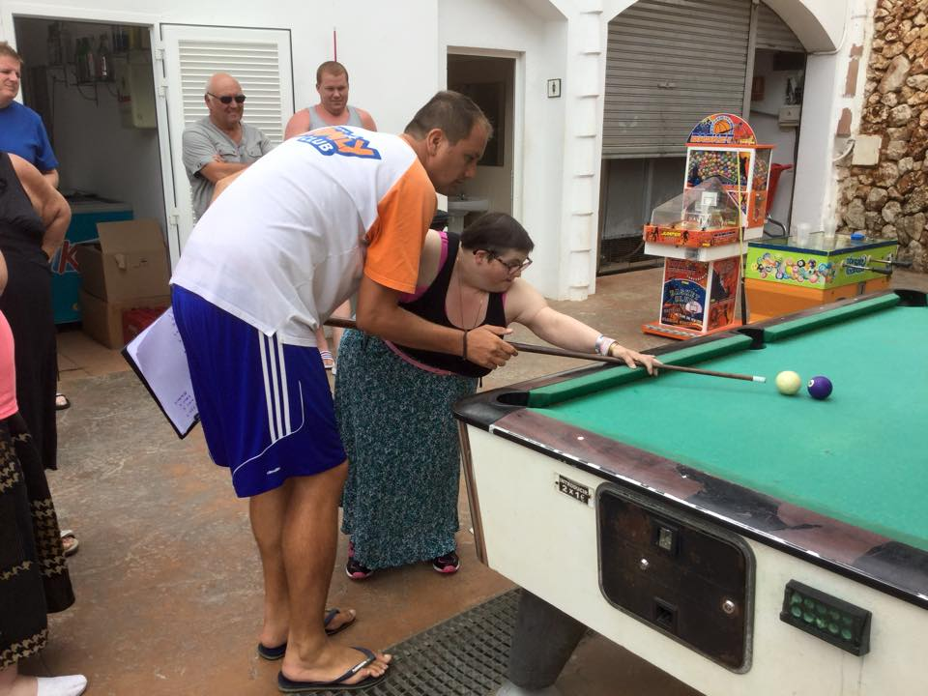
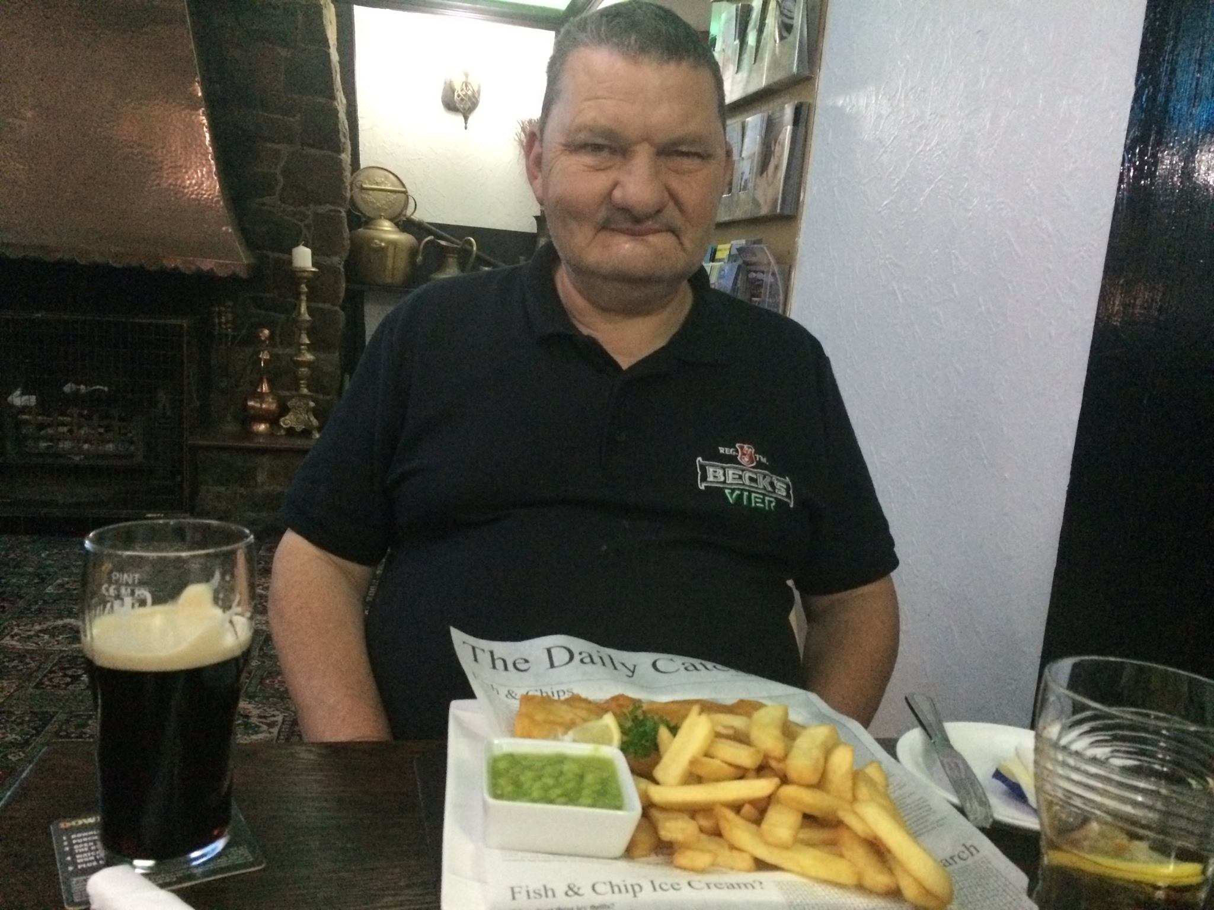
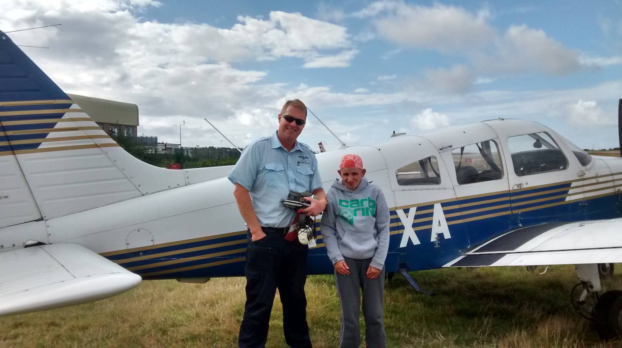
Choice
Notes:
At Les Amis we enable the residents and SU to make their own choices the same way as we do!
Making choices is something we take for granted, we are making choices all the time from when we wake up. What to wear, what to have for breakfast, when to leave for work…etc.
Some of the residents don’t have that privilege because of their learning disability.
These pictures show how are residents make their own choices.
This is Val, she is a complete adrenalin junkie! Here she is completing her first sky dive, in fact Val has now done 4 sky dives! This is Val’s choice, obviously jumping out a plane is a massive risk but we’re here to support Val’s choices and to make sure the residents are aware and understand all the risks involved but at the end of the day it is Val’s choice.
We often ask new recruits what they would do if a resident decided to start smoking. How would you support that? We would make them aware of all the health risks, explain the cost of smoking…but we are there to make sure the risks are minimised for them. Maybe you would make them aware of Vapours BUT we have to remember if a residents makes that choice to smoke then that is their choice.

Slide 7
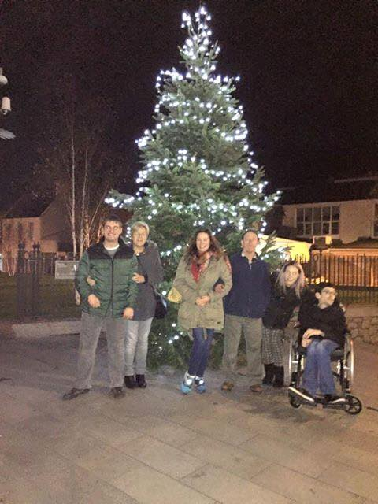
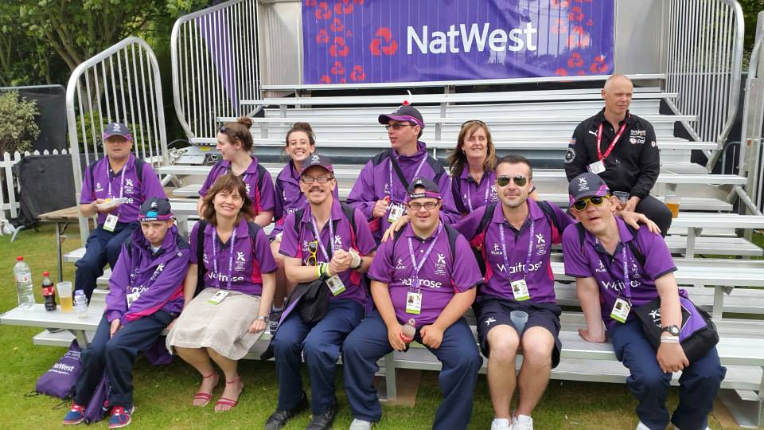
Community Presence
Notes:
At Les Amis we ensure our residents have equal opportunities and are present within the community.
Years ago people with learning disabilities would be kept out of the community. Nowadays there is better understanding of learning disabilities and our residents are involved in the community as much as we are.
Island Games – Games Makers, Same training, World Host recognised Customer Services training.
Choir – Christmas Choir, started a few years ago in one church now other churches are approaching us to be involved in their Christmas Carol Service.
Battle of Flowers this year x 4 awards!

Slide 8
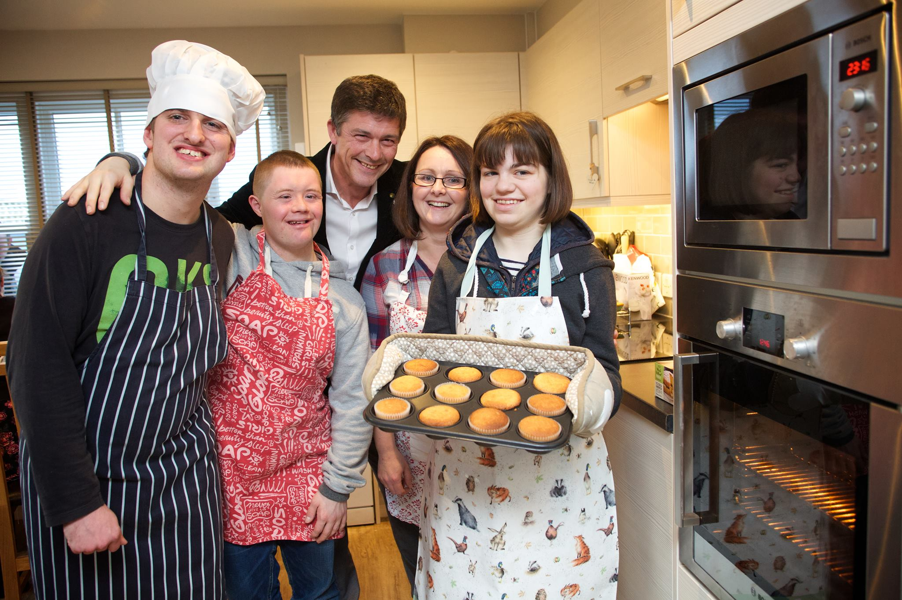
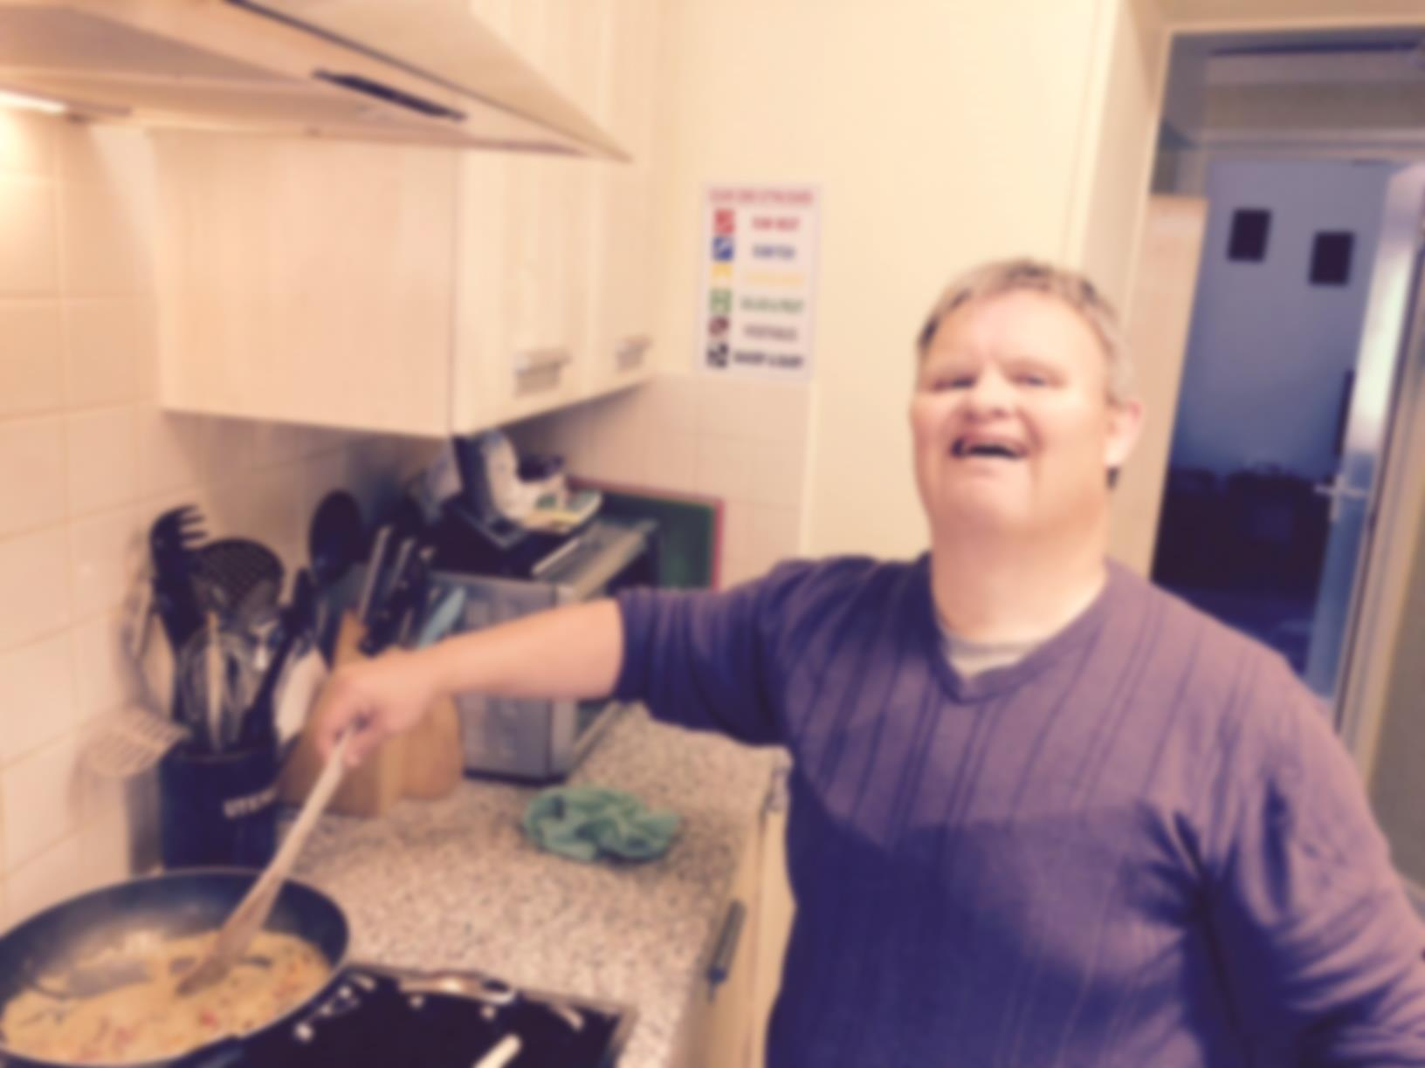
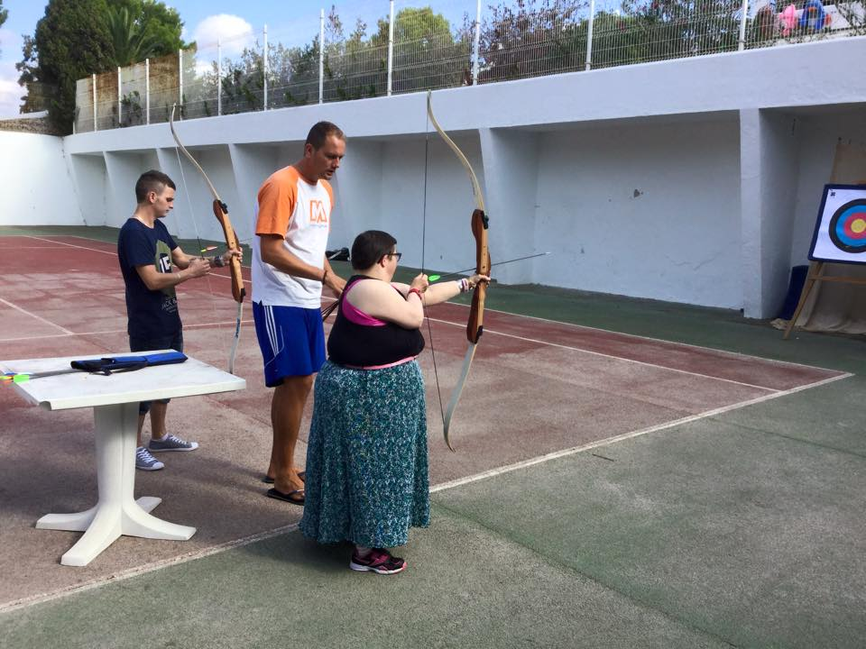
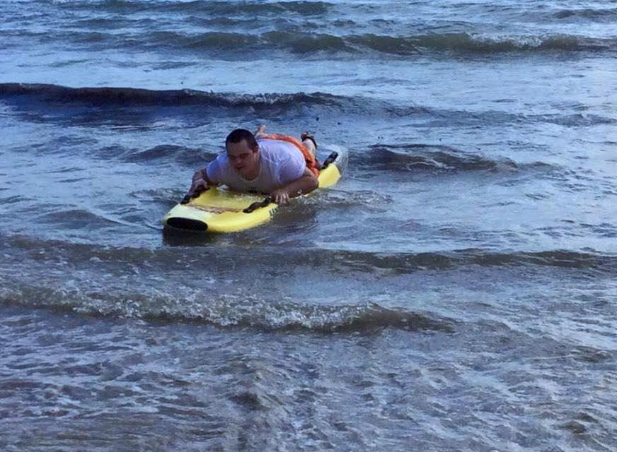
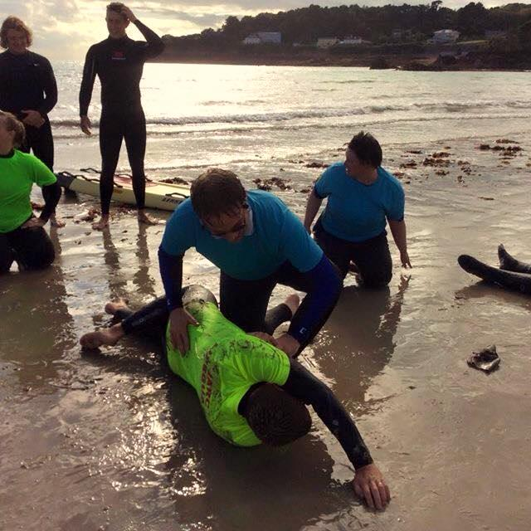
Competence or Capability
Notes:
We are supporting people to gain new skills, it is all about up-skilling.
Can be from cooking, to reading even life saving!
One of residents said they would love to be a life guard so some of the support workers arranged for residents to be life guards for a day! Where they learnt first aid and learned how to conduct a rescue.
If a resident shows an interest in learning a new skill our job is to provide the resources and contacts to build and develop those skills.

Slide 9
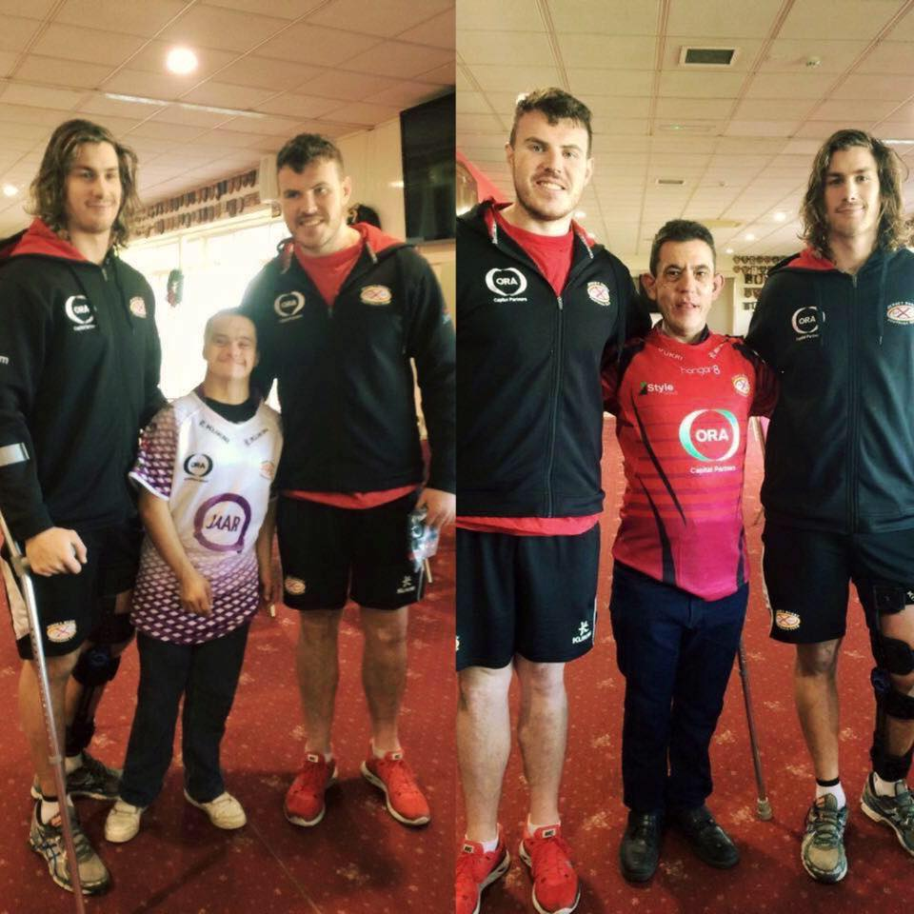
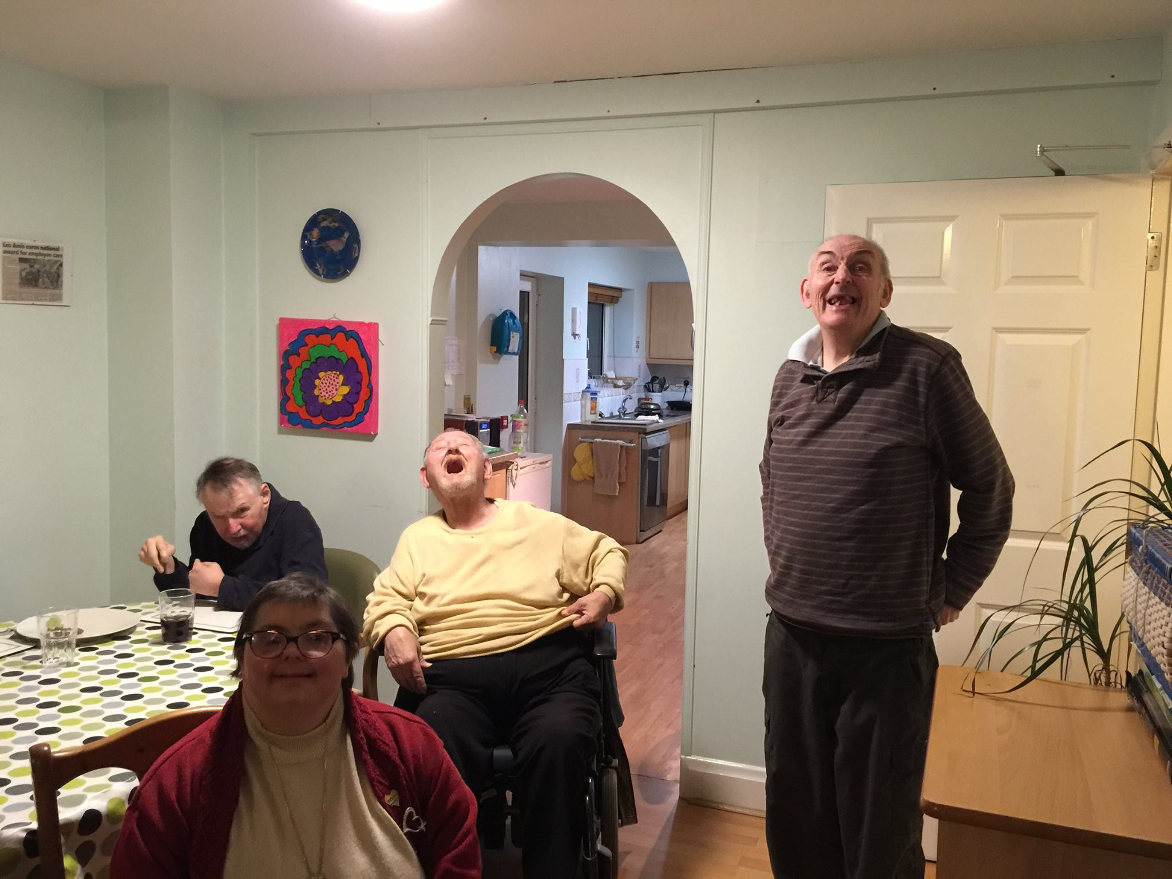
Participation or Relationships
Notes:
This is all about ensuring our residents maintain positive relationships inside AND outside Les Amis.
Maintaining relationships and making new friendships outside of Les Amis is really important for our residents.
In Jersey people with learning disabilities often go to school, live with or work with the same people! I don’t know about you but if I lived or worked with all the same people I went to school with I’d be getting pretty fed up with them by now!....and it is no different for our residents.
Example is Jersey Rugby Club – there are some fans amongst our residents. Often our residents will integrate with team and make new friendships.

Slide 10
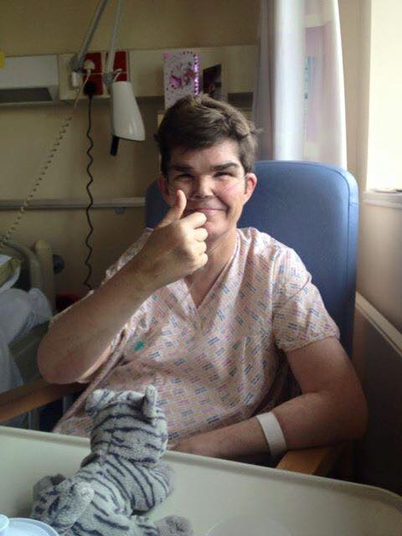
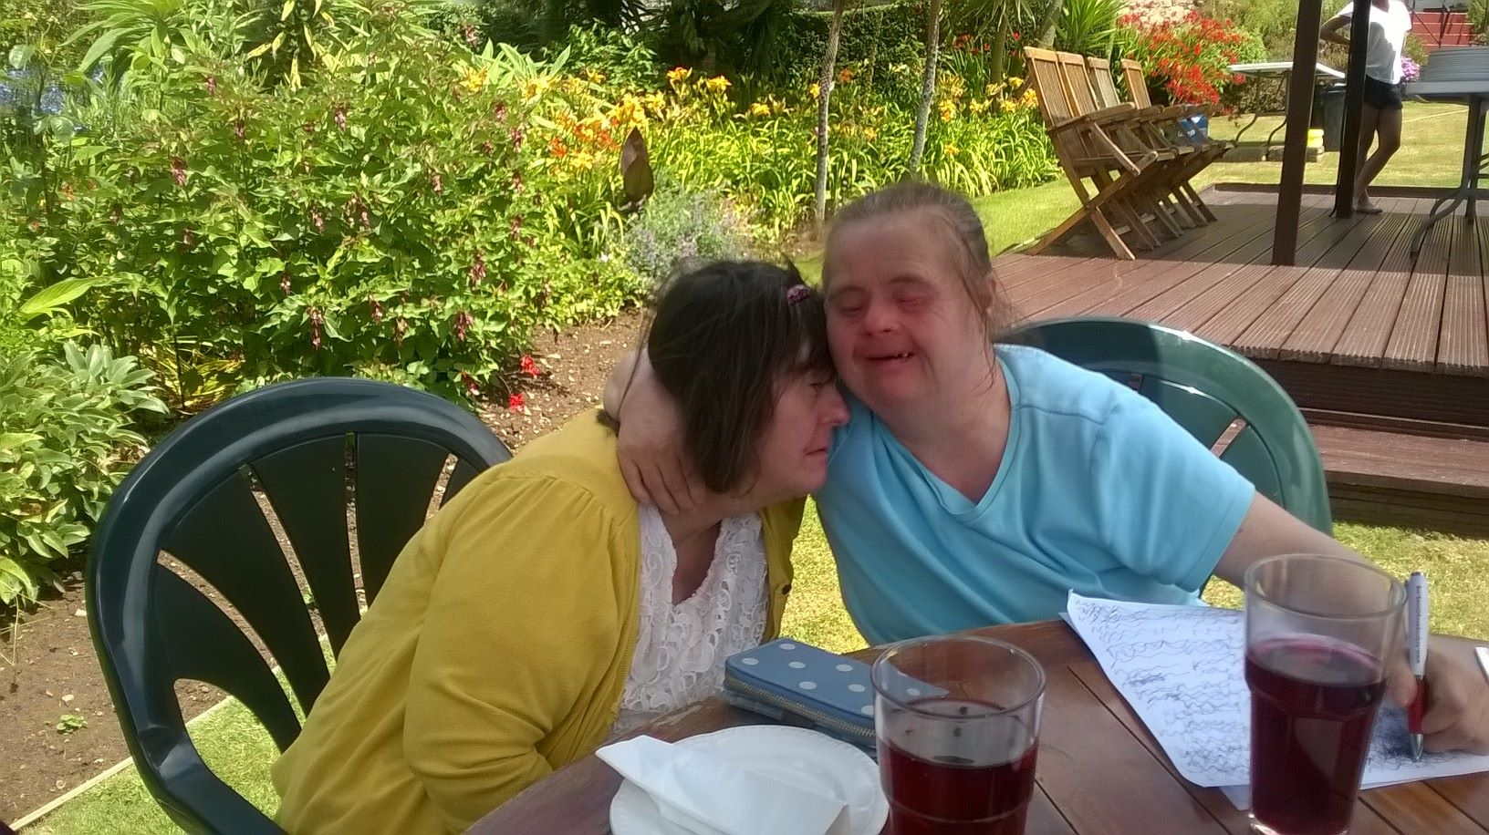
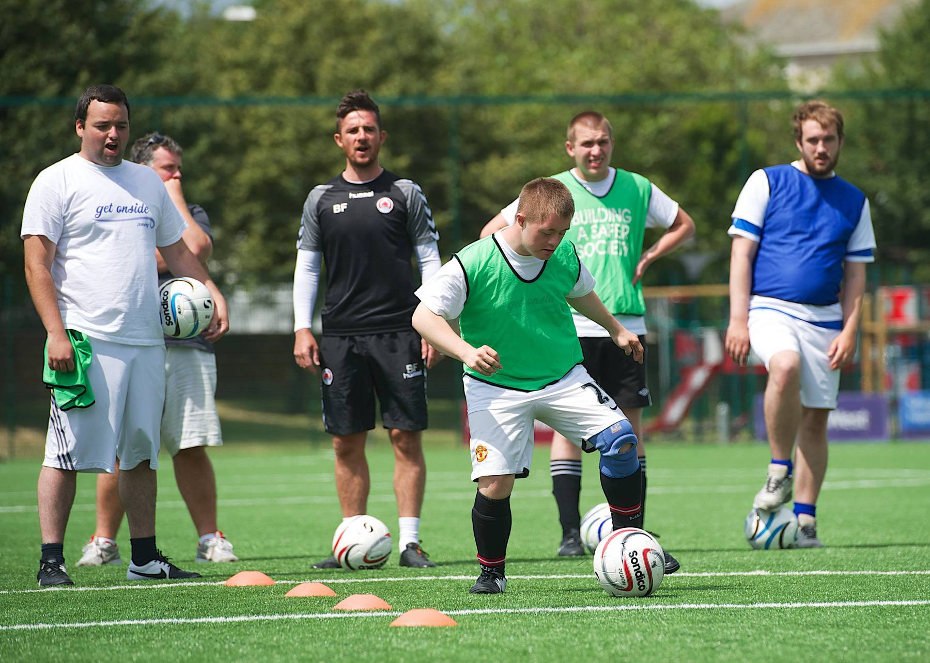
Respect or Dignity or valued Roles
Notes:
Not much to say here other than Les Amis staff respect the residents and the residents respect the staff!
If one of our residents is unable to do something it is about looking for alternative ways to do it!
It’s all building respect and giving them values and building their self-esteem.

Slide 11
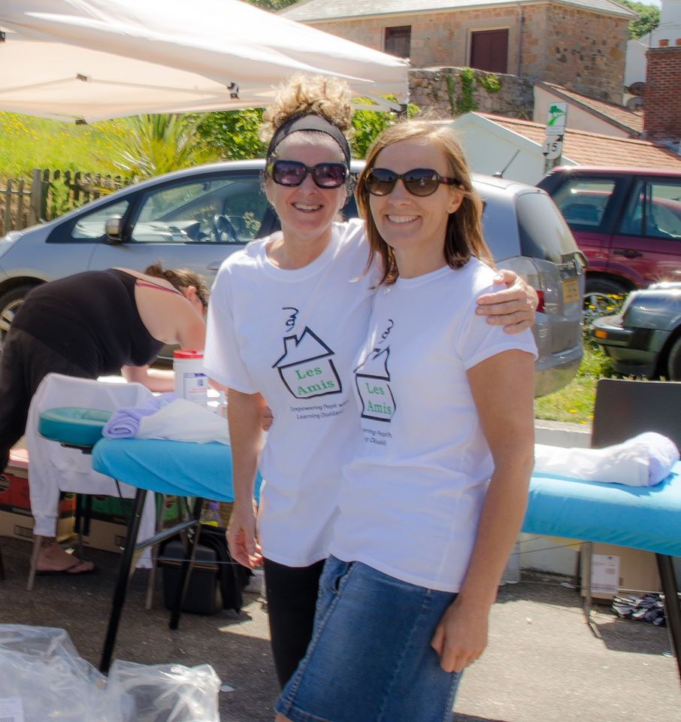
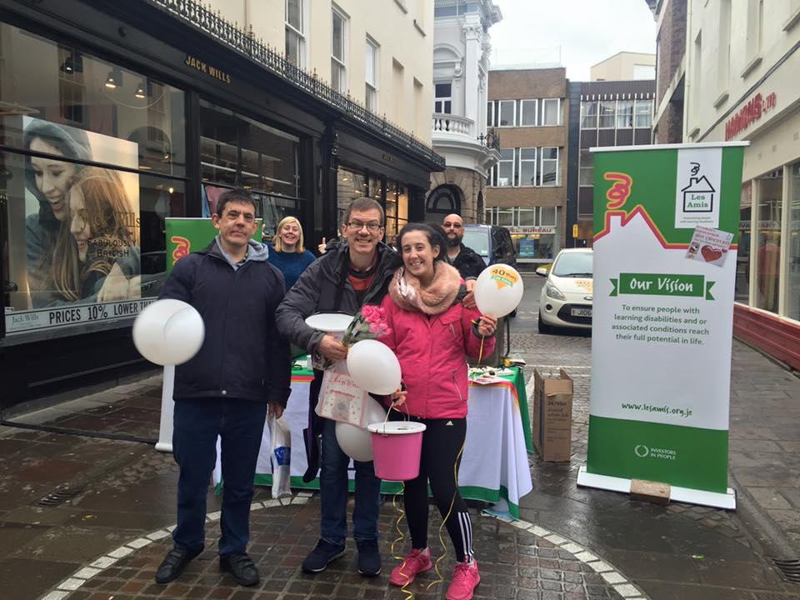
Customer Service
Residents are central to everything we do
Fully trained staff
Strong ethos throughout organisation
Promoting Les Amis and raising awareness
Notes:
Customer service:-
Listen to our customer, our residents and service users – resident surveys, residents meetings,
Listen to our staff who are the forefront of the organisation – staff surveys, focus groups, staff involvement in changes, good communication, rewards and recognition and a people strategy. Through this process we have been awarded Investors In People Silver Award; top 5% of all organisations who have been assessed
We have a strong ethos at Les Amis and expect a high standard of support for our residents , to achieve this we ensure all of our staff are fully trained to meet requirements of role:- New staff take part in a 12 week induction, which includes all the mandatory training and ensures that they have a good knowledge and understanding of the role before being signed off as competent.
We have a robust management system in place that provides a level of governance throughout the organisation, this ensures that we are always working to the highest standard of support.
Professional relationship with external organisations and families, promotes good partnership working and customer service.
Les Amis has a great reputation on the Island and the past few years we have done a lot of promotional work to help raise awareness of the charity, we won several awards including CIPD (Chartered Institute for Personal Development, most successful change management programme in 2015), we won Charity of the year and won Large not for profit organisation of the year.

Slide 12
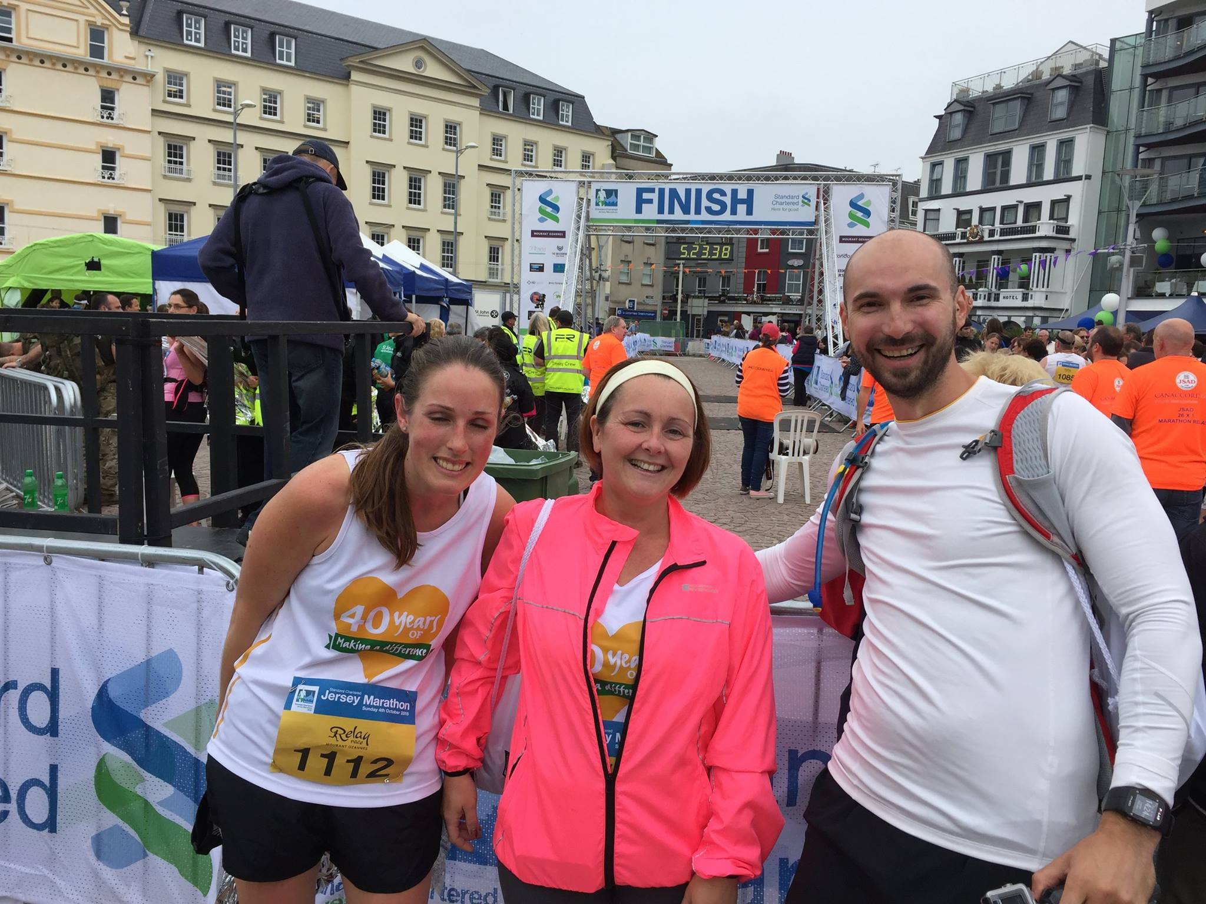
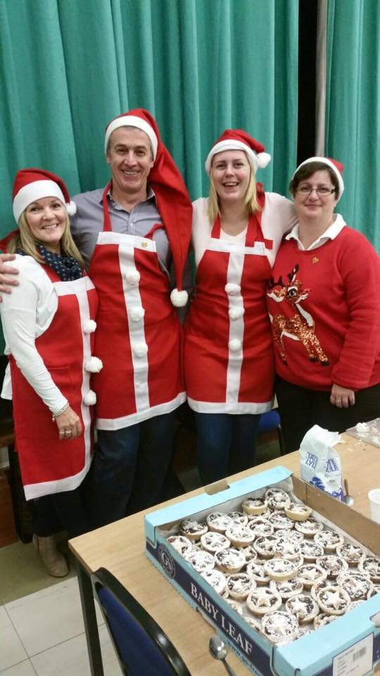
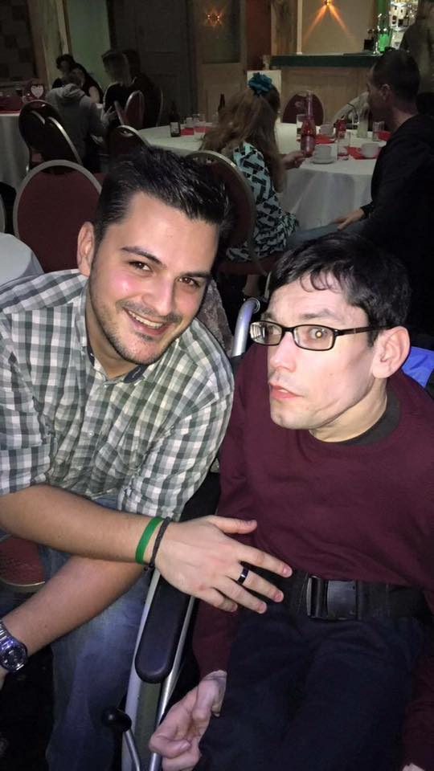
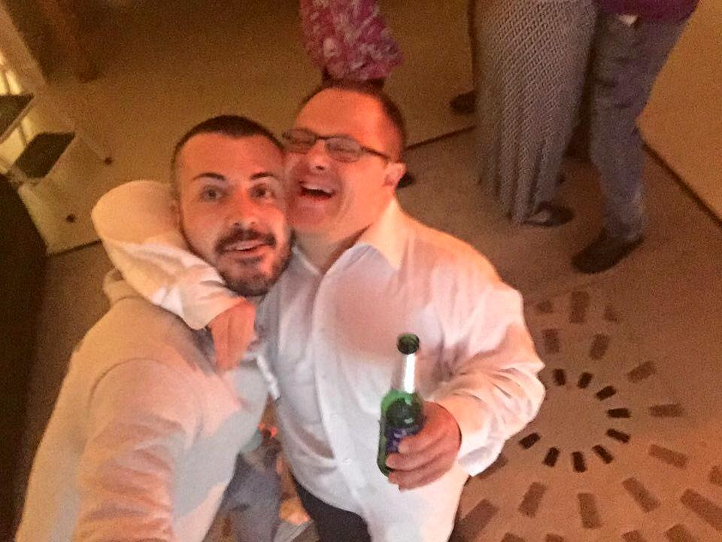
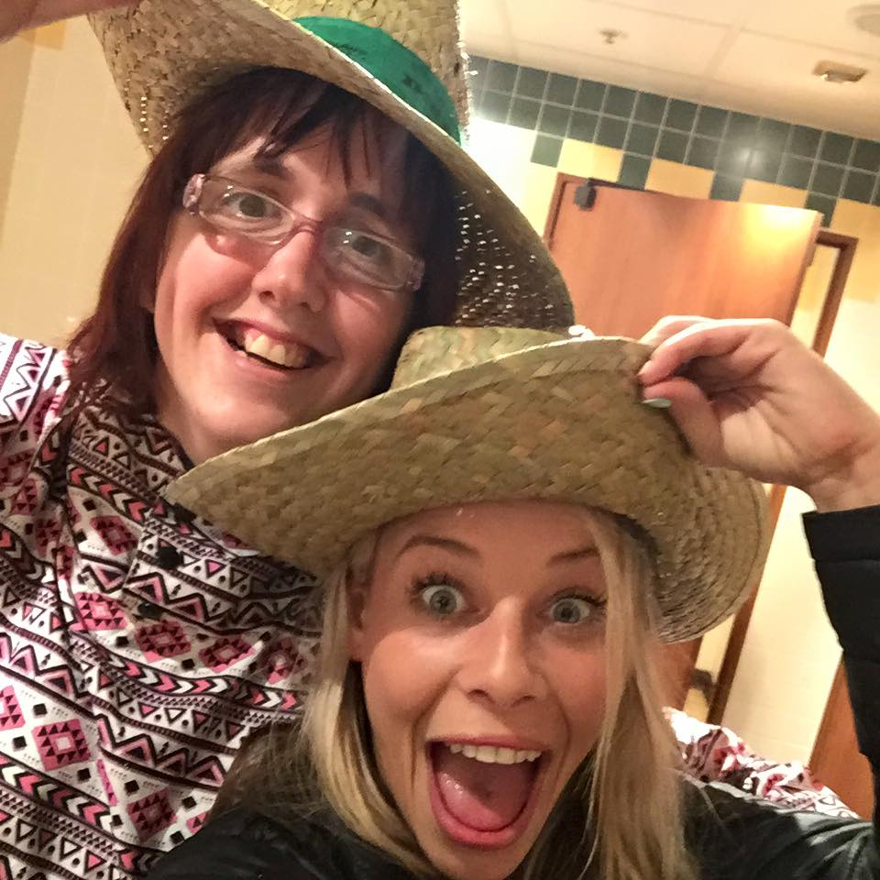
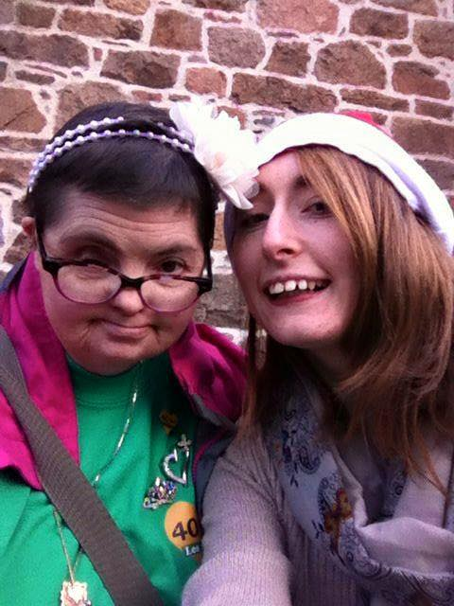
Notes:
What I personally believe to be the at the heart of the customer service at Les Amis, is the pride and love that the staff have for their jobs. The positivity and proudness that shines through when staff talk about the residents they support and the organisation they work for is what I believe to be one of the most important factors in customer service.

