Slide 1
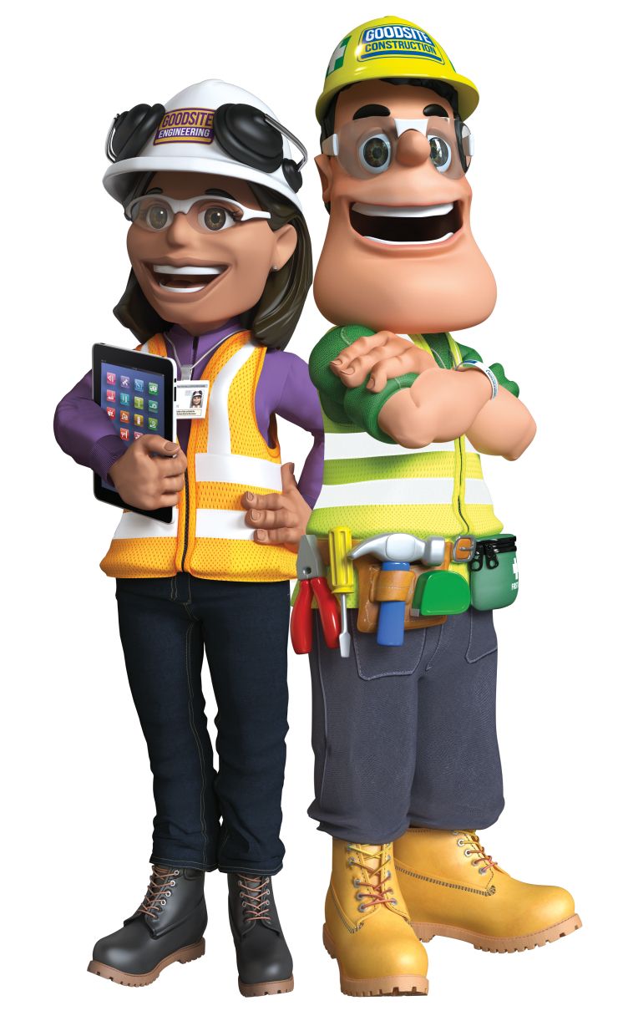
Ivor and Honor’s
Careers in Construction
Notes:
*Introduce yourself: Who do you work for? What is your role? How long have you worked there? How long have you worked in the construction industry?*
I would like to welcome you to Ivor and Honor’s Careers in Construction Presentation! Today we’re going to expose some common stereotypes surrounding the construction industry and with the help of Ivor and Honor, try to persuade you to think about a career in construction!

Slide 2
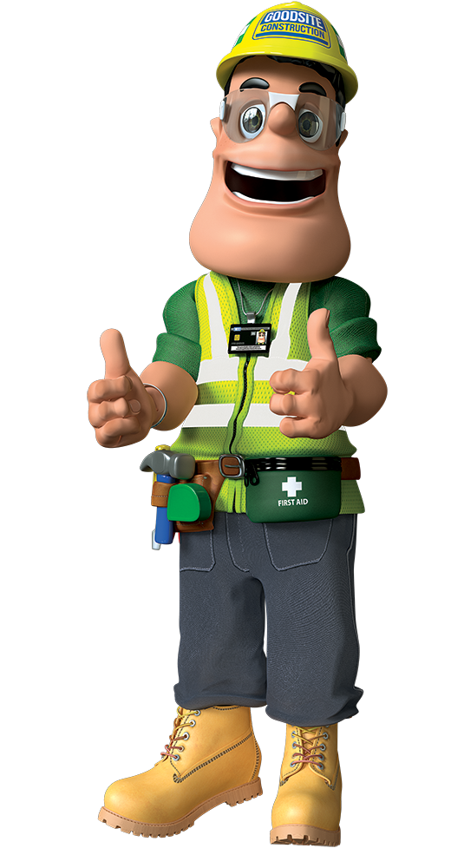
Meet the Team
Name:
Company:
Job:
Skills:
Likes:
Dislikes:
Ivor Goodsite
Goodsite Construction
Owner and Site Manager
Environmentally aware, trained first aider
Construction, big machinery, teaching children the importance of safety
Incorrect PPE (Personal Protective Equipment), deep holes, children in danger
Notes:
*Animation 1 – brings up Ivor’s information*

Slide 3
Meet the Team
Name:
Company:
Job:
Skills:
Likes:
Dislikes:
Honor Goodsite
Goodsite Engineering
Structural Engineer
Excellent at problem solving, a maths and science whizz
Promoting careers in construction, protecting the environment and art
Untidy sites, litter, unfair treatment and bullying
Notes:
*Animation 1 – brings up Honor’s information*

Slide 4
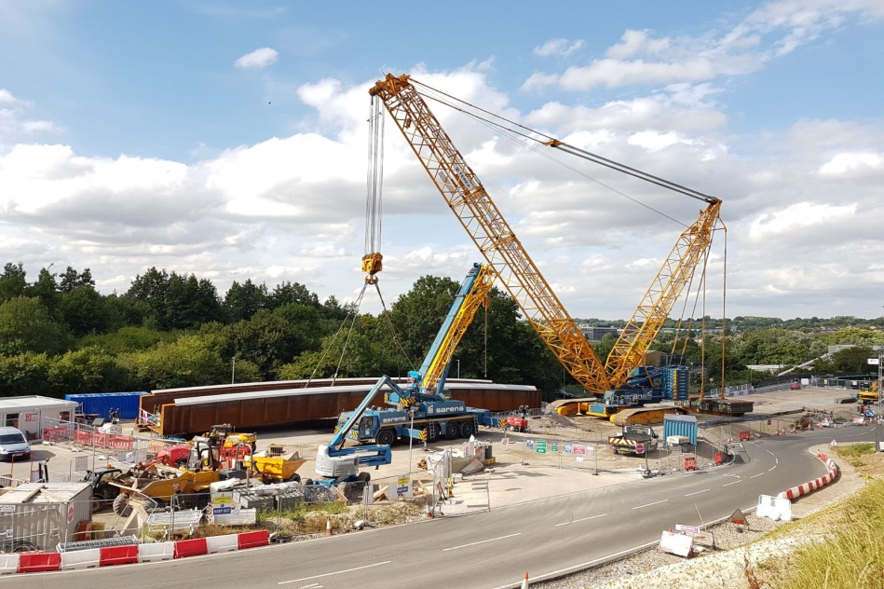
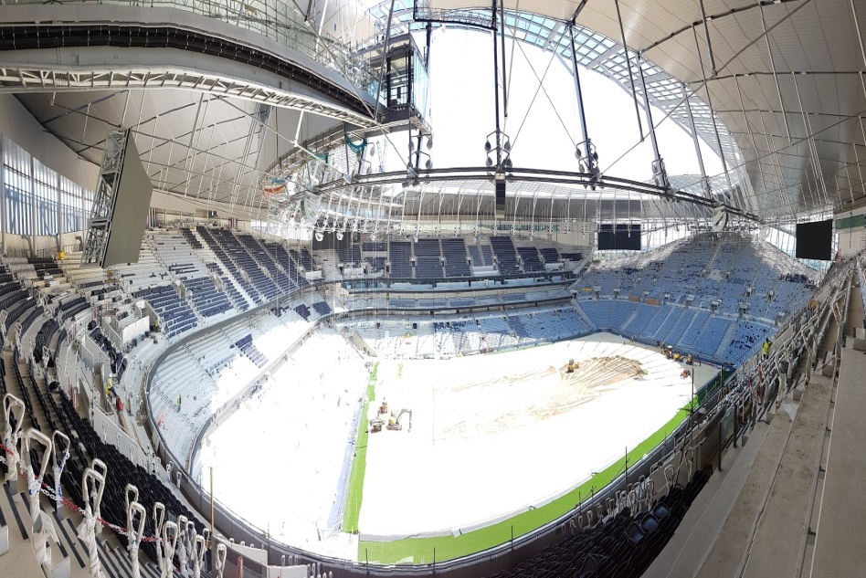
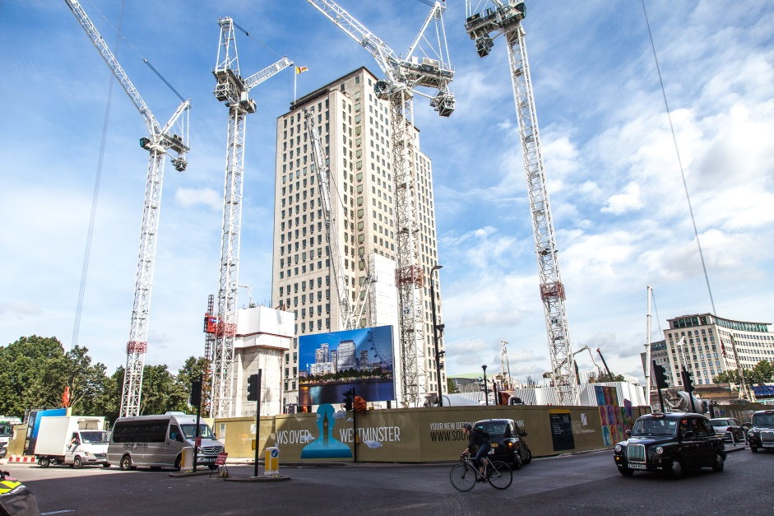
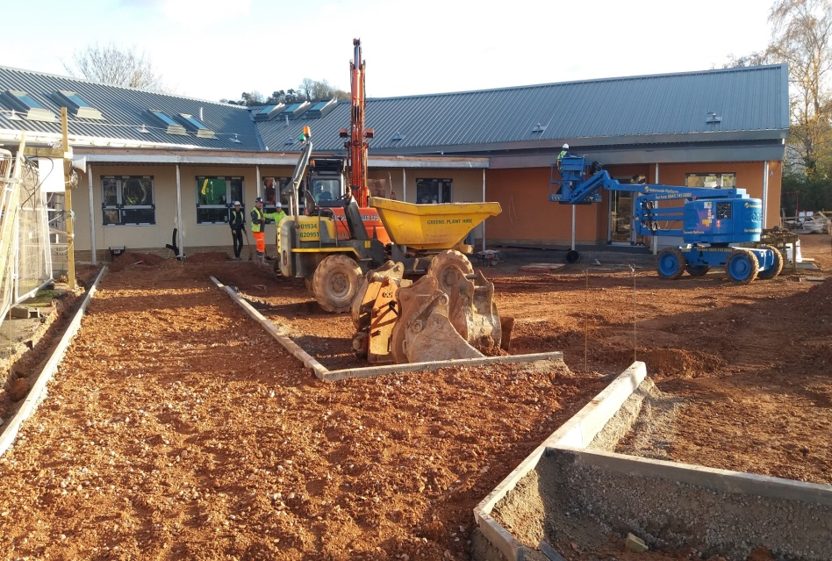
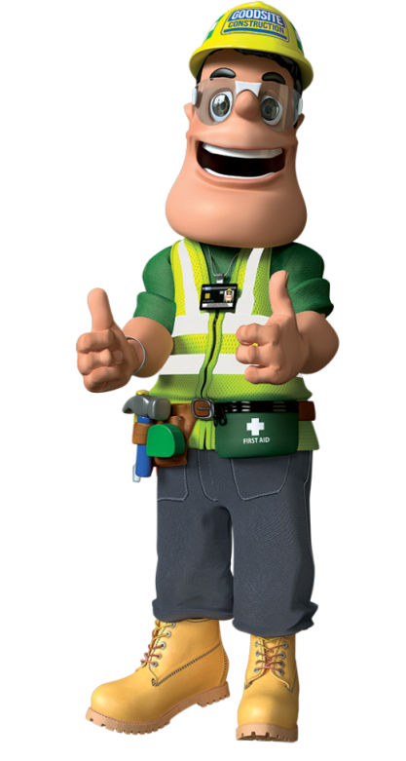
“What is Construction?”
Construction is the action of building something!
Notes:
Ask the audience: What is construction?
*Allow time for audience to participate and try to answer*
*Animation 1 – Brings up Ivor and the answer*
Construction is the action of building something. This can be anything from a road or school to a bridge or skyscraper. Construction is going on all around us, every single day. The bigger the project, the longer it will take to build. Some projects can last a few weeks and will have a team of fifteen people, whereas larger projects can take years and will have hundreds of workers on site every day.

Slide 5
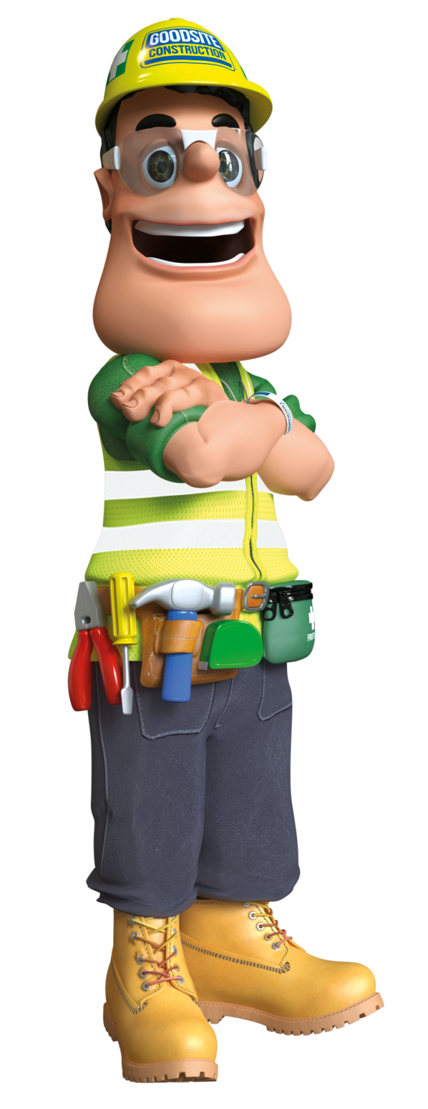
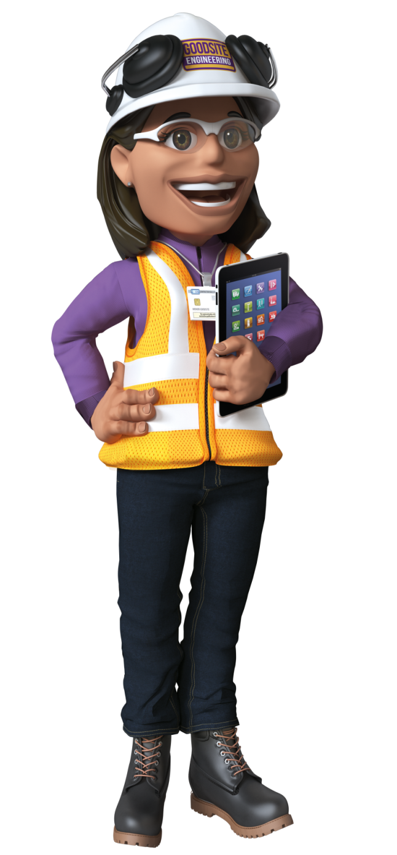
“What jobs are available in Construction?”
Community Liaison Officer
Marketing Manager
Environmental Manager
Safety Advisor
Crane Operator
Site Manager
Sustainability Officer
Plant Operator
Mechanical Engineer
Steel Erector
Scaffolder
IT Assistant
Welding Fabricator
Buyer
Document Controller
Roofer
Architect
Bricklayer
Glazier
Carpenter
Plumber
HR Manager
Project Manager
Site Inspector
Surveyor
Plasterer
Civil Engineer
Electrician
Painter and Decorator
Banksman
Notes:
Ask the audience if they know what jobs are in the construction industry. *Allow time for audience to participate and try to answer.*
(Animation 1-10: Tap through at your own pace - feel free to explain any of the roles that appear on the slide as you go through them – or ask the audience to explain them if they can!)
The construction industry has over 150 unique, exciting roles available for you to choose from, the ones mentioned here are just scratching the surface!

Slide 6
Industry Stereotypes
x
Notes:
Now that we’ve gone through a few of the hundreds of roles available to you in construction, shall we discuss some well-known stereotypes about the industry?
*Animation 1 brings up the tick and X*
For the next section of slides, I want you to all answer honestly about whether you agree or disagree with the following statements with a simple thumbs up for “yes” or thumbs down for “no”.

Slide 7
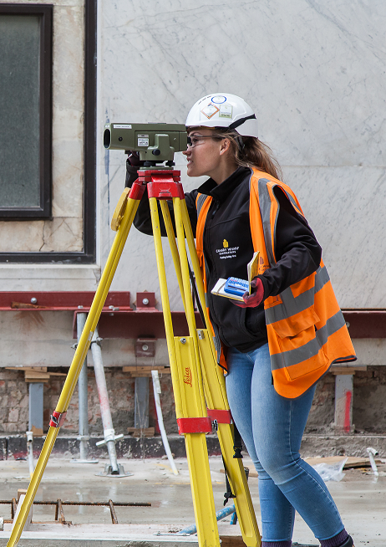
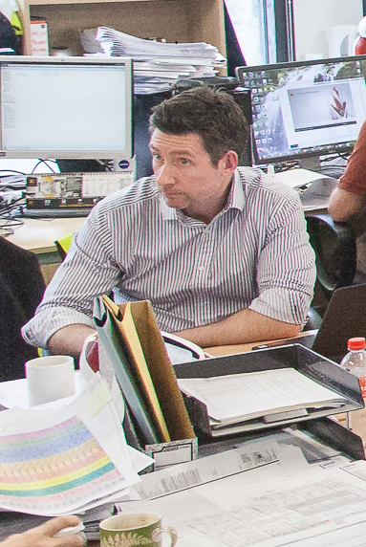
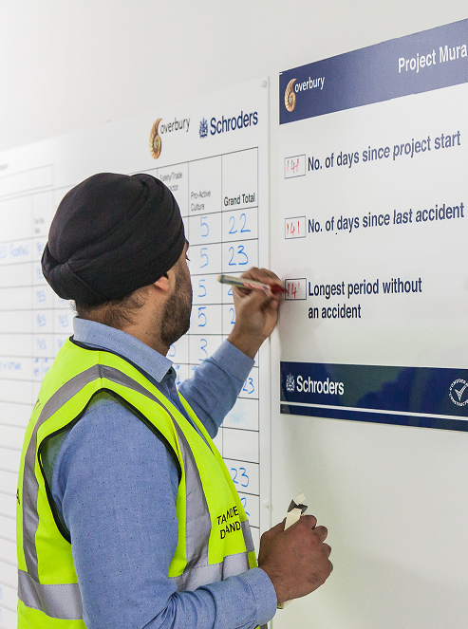
“Construction work is dirty so I don’t want to do it.”
x
Quantity Surveyor
Marketing Manager
Health, Safety and Environment Advisor
Notes:
“Construction work is dirty so I don’t want to do it.”
Ask the audience if they agree or disagree with the statement.
Thumbs up agree
Thumbs down disagree
*Animation 1 brings up the X*
Thumbs down are correct!
There are hundreds of different careers within construction and the Built Environment that can get you off the construction site and involve designing, managing and engineering that do not involve getting your hands dirty! Can anyone name a few? Ivor and Honor may have mentioned a few in the previous slide… We also have a few examples for you.
*Allow time for audience to participate and try to answer*
*Animation 2 brings up Quantity Surveyor*
Quantity Surveyor – Ask the audience if they know what a surveyor does.
Prepare tender and contract documents to secure work for their organisation.
A Quantity Surveyor will work out the cost of repair or maintenance works, establishing exactly what the client wants done.
The QS will allocate work to subcontractors, ensuring that the client gets value for their money.
Lastly, the Quantity Surveyor will make sure that the project meets every legal and quality standard.
*Animation 3 brings up Marketing Manager*
2. Marketing Manager – Ask the audience if they know what a Marketing Manager does.
Monitors the public and media’s opinion of a client or employer.
Arranges advertising for the client or employer.
Managing social media posts and training employees to handle media enquiries.
Managing, arranging and representing the company events.
*Animation 4 brings up HSE Advisor*
3. Health, Safety and Environment Advisor – Ask the audience if they know what one does.
Supporting managers and employees to implement health and safety.
Undertaking incident/accident investigation and report writing.
Undertake risk assessments and site inspections to consider how risks can be reduced.
Deliver site safety inductions and holding health and safety meetings.

Slide 8
“It’s only boys who can work in construction.”
x
Crane Operator
Plasterer
Resident Liaison Officer
Notes:
“It’s only boys who can work in construction.”
Ask the audience if they agree or disagree with the statement.
Thumbs up agree
Thumbs down disagree
*Animation 1 brings up the X*
Thumbs down are correct – again!
In 2016, the number of women directly employed in construction hit a 20 year high, and women are expected to make up over a quarter of the UK’s construction workforce by 2020. At the moment we have over 320,00 women working in the construction industry with 92% of them being employed in professional roles, such as Civil Engineers, Architects and Quantity Surveyors. You will also find women in the construction industry working in both administrative and practical roles too! Can you name any?
*Animation 2 brings up Crane Operator*
Crane Operator – Ask the audience if they know what one does.
Moving materials according to a plan or schedule.
Conducting daily maintenance checks and reporting any issues to your supervisor.
Keep records of material movement.
Overhead Crane Operators ensure that travel routes are clear and avoid lifting anything over people. They will often sling the loads themselves.
*Animation 3 brings up Plasterer*
2. Plasterer – Ask the audience if they know what one does.
Plasterers are incredibly important to most building sites, you will be part of a small team, doing either solid or fibrous plastering.
You will mix and apply different types of plaster to walls inside a building and ceilings so that they can be decorated.
Plasterers also create ornamental plasterwork, such as ceiling roses or patterns using a mixture of plaster and short fibres shaped with moulds and casts.
*Animation 4 brings up Resident Liaison Officer*
3. Resident Liaison Officer – Ask the audience if they know what one does.
Hosting and attending community meetings, allowing attendees to express concerns or issues with the project.
Leading community engagement activities such as fun days, apprenticeships or work experience schemes.
Giving presentations to community organisations i.e to show progress on works.
Ensuring planning obligations are met.
Making sure that the contractor has the best possible relationship with its community.
Remember: women can fulfil any role they wish within the construction industry. There is no such thing as a female or male-only job. A career in construction is extremely rewarding with 76% of women in construction recommending a career in the industry to other women.

Slide 9
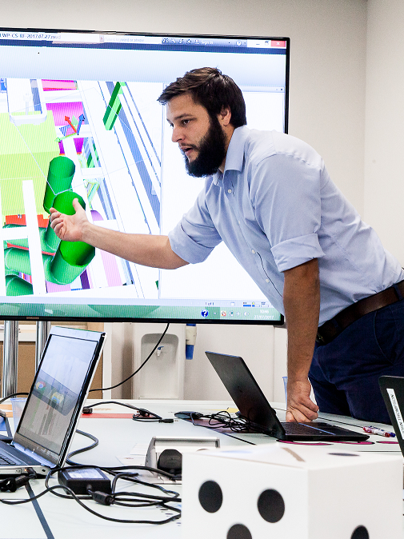
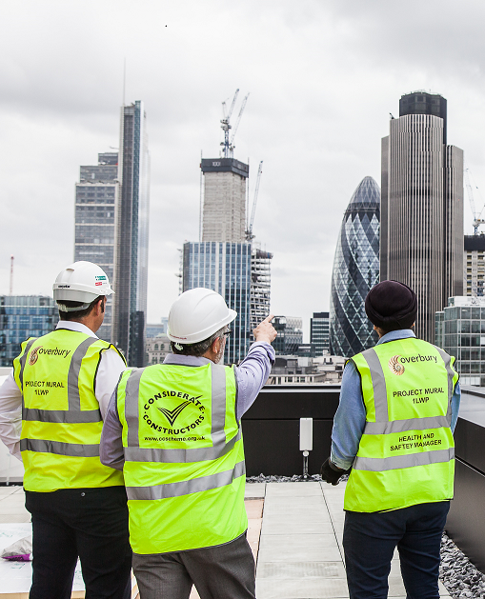
“Construction is for people who didn’t do well at school.”
x
Architect
Civil Engineer
Project Manager
Notes:
“Construction is for people who didn’t do well at school.”
Ask the audience if they agree or disagree with the statement.
Thumbs up agree
Thumbs down disagree
*Animation 1 brings up the X*
Thumbs down win again!
A career in construction is not just for those who “didn’t do well at school.” You can study Higher Apprenticeships or Degree Apprenticeships. Some companies might even pay your tuition fees! There are lots of well-paid career opportunities in the construction industry for people who are educated to degree level or higher. Once you have your degree, many employers will have recognised graduate development programmes. Managing a multi-million pound construction project requires exceptionally high levels of skill and ability – they don’t just let anybody do it!
Can anyone name any roles that require further education to pursue?
*Give audience time to answer*
*Animation 2 brings up Architect*
1. Architect – Can anyone tell me what this role entails?
This role sees you advising on restoration and conservation of existing buildings alongside designing new ones that meet your clients demands..
You will ensure building regulations, planning laws and environmental considerations are met by working closely with contractors, engineers and surveyors as the building goes up, inspecting them as they do so.
Architects will use computer design programmes to produce drawings, detailed workings and specifications of the project they are working on.
Senior architects lead a team of architects through each phase of a buildings design and construction.
*Animation 3 brings up Civil Engineer*
2. Civil Engineer – does anyone know what one does?
When you become an engineer, you would choose to specialise in a particular area:
- Structural – Just like Honor! (dams, building, offshore platforms and pipelines).
- Transportation (roads, railways, canals and airports).
- Environmental (water supply, drainage and flood barriers).
- Maritime (ports, harbours and sea defences).
- Geotechnical (mining, earthworks and construction foundations).
Each of these roles works differently but we will cover the basics of the role together:
Engineers will assist with potential site investigations and will develop detailed designs which assess the potential risks of specific projects.
It’s an engineers job to think creatively and logically to solve design and development problems. They will also have to manage change – clients may change their mind halfway through a project and they will need to notify the relevant parties.
Prepare bids for projects using computer modelling software to analyse data you have gathered.
After working as a Civil Engineer, you can become a Senior or Principal Engineer – these roles require Chartership with the Institute of Civil Engineers or ‘ICE’ for short.
*Animation 4 brings up Project Manager*
3. Project Manager – can anyone tell me what this person does?
Your role as a Project Manager is to understand what the client or company want to achieve. You will agree timescales, costs and the resources needed with them in order to deliver the project successfully.
You will select and lead a project team of your choice and negotiate with contractors and suppliers for materials and services to get the job done on time.
You will direct a multi-disciplinary team to ensure that every stage of the project is progressing on time, within the budget set and to the highest standards.
Project Managers will regularly report the progress of the project to the client and will maintain effective communication with the stakeholders of the project.
You will resolves any issues or delays which may occur during the project development and manage several projects simultaneously with a team of junior project managers to support you.

Slide 10
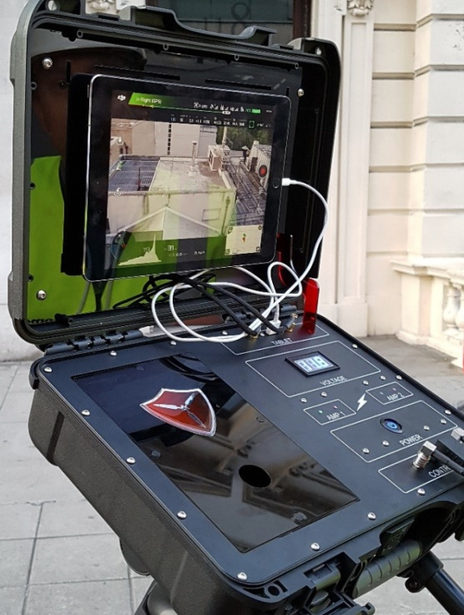
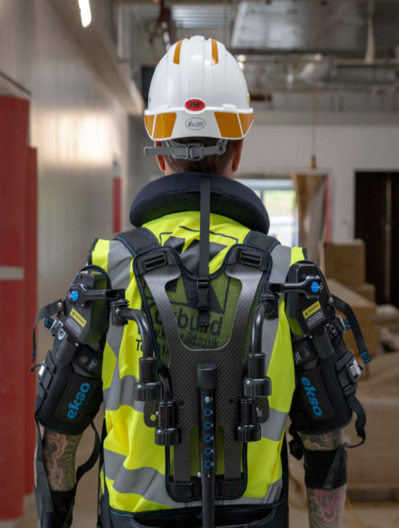
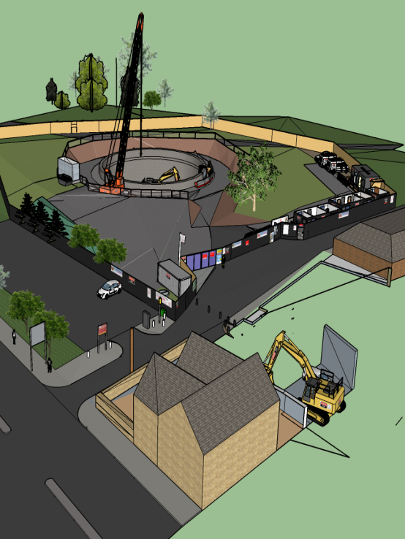
“Construction is an old, outdated industry.”
x
Drones
Exoskeletal Suit
Building Information Modelling (BIM)
Notes:
“Construction is an old, out-dated industry.”
Ask the audience if they agree or disagree with the statement:
Thumbs up = agree
Thumbs down = disagree
*Animation 1 brings up the X*
Thumbs down are correct!
Although the construction industry may appear to be all hammer and nails, it is actually one of the fastest evolving industries in the world. Construction companies are really beginning to move with the times and are using the latest technology and innovation to make the process of construction more efficient and safer for their employees, some examples of this are:
*Animation 2 brings up Drones*
1: Drone technology
An increasing number of construction companies are beginning to use drones on their sites for a number of reasons. One particularly innovative way is to use drones to deliver first aid equipment across the construction site. Should there be an incident, a trained first aider will be able to ‘radio-in’ a drone that has a first aid kit and defibrillator attached so that the injured member of staff can be treated.
Another use for drones is to monitor their own sites tidiness and cleanliness. Companies will fly the drones both over and around the outskirts of the site to monitor its cleanliness. Anywhere a mess is found, a team will be sent out to tidy it up ensuring that the site is projecting the very best image of the construction industry.
Drones can also be used to measure the stockpile levels on sites of various materials. The benefits of this is that it eliminates the need for employees to work at height, more efficient than sending a team of people to do it, it gives highly accurate information on how much stock you have and allows the people that would normally do that job, to carry out their other duties.
*Animation 3 brings up Exoskeletal Suit*
2: Exoskeletal Suits:
Exoskeletal suits have the potential to revolutionise the way people work in the construction industry by reducing the strain and exertion that is unavoidable when carrying out manual tasks.
The suit is optimised to support the weight of the operatives arms when working overhead or carrying items by safely transferring the loads associated with these tasks through a ‘secondary’ skeletal system down to the upper legs.
The vest works off a spring-based assistance system and when activated, will provide 5-15lbs of assistance per arm, augmenting the user’s natural physical ability, meaning that it will remove the stresses and strains associated with manual tasks.
*Animation 4 brings up BIM*
3. Building Information Modelling (BIM):
BIM is a process for creating and managing information on a construction project across the project life cycle. Through this technology, the construction industry is going through its very own digital revolution!
This programme brings together all of the information about every component of a building in one place, by integrating all of the different aspects of a project into one.
BIM data can be used to illustrate the entire building life-cycle, from brick to brick, from inception and design to demolition and material reuse.
BIM can show the products properties such as thermal and electrical performance, it can show the products physical characteristics like all of the wiring and piping inside the walls of the structure.

Slide 11
“I can’t earn lots of money if I get a job in the construction industry.”
x
Roofer
£50,000
Planner
£30,000
Plasterer
£60,000
Bricklayer
£58,000
Architect
£70,000
Estimator
£55,000
Field Technician
£28,000
Civil Engineer
£45,000
Site Manager
£35,000
Rig Driver
£48,000
Building Control Surveyor
£32,000
Sustainability Coordinator
£40,000
Notes:
“I can’t earn lots of money if I get a job in the construction industry.”
Ask the audience if they agree or disagree with the statement.
Thumbs up agree
Thumbs down disagree
*Animation 1 brings up X*
Thumbs down are correct!
Like any job anywhere, if you work hard and progress, you will earn good money. The construction industry is no different. However, with that being said, demand for workers within the industry has never been higher. According to the Construction Industry Training Board (CITB), the industry will need a quarter of a million workers in the next few years to keep up.
With the demand being so high, the wages you can receive are highly competitive. For instance, a university graduate can earn upwards of £60,000 per annum along with other perks, such as a company vehicle. Those who go straight into the industry from school can also earn sums like the aforementioned when working in trades i.e. an Electrician.
Below will be just 12 out of the hundreds of roles available in the construction industry, we’re going to play a game and see if you can match the role to the average annual income of the position once you hear what each of them does (FYI: the income parallel to the role is not the answer – they have been put in a random order):
Answers:
*Animation 3* Roofer: Roofers work on protective layers of a building which separate the inside from the elements, using a range of different methods and materials - £35,000
*Animation 4* Planner: Planners are fundamental when it comes to the execution of a building project, they will create a programme of works to help achieve its successful completion - £55,000
*Animation 5* Plasterer: Plasterers are indispensable to building sites, they make walls and ceilings smooth and ready for decorating - £28,000
*Animation 6* Bricklayer: Bricklayers lay bricks, pre-cut stone, concrete blocks and other types of building blocks in mortar to construct or repair walls, foundations, partitions, arches and other structures - £30,000
*Animation 7* Architect: Architects have the challenging and extremely satisfying job of bringing whole new buildings into the world. They also save, restore and change the ones we already have built - £50,000
*Animation 8* Estimator: Estimators calculate how much it costs to supply products or services to a client before building works can begin - £70,000
*Animation 9* Field Technician: Field technicians travel to construction sites to fix equipment problems - £32,000
*Animation 10* Civil Engineer: Civil engineers have the crucial role of planning, designing and managing construction projects - £60,000
*Animation 11* Site Manager: Site managers run the workforce on a building site - £58,000
*Animation 12* Rig Driver: Rig drivers operate construction equipment to drive columns of materials such as wood, steel or concrete into the ground to support buildings and other structures - £45,000
*Animation 13* Building Control Surveyor: Building control surveyors make sure that regulations are followed on construction sites and projects - £40,000
*Animation 14* Sustainability Coordinator: Sustainability coordinators oversee the implementation of sustainability strategies during a project - £48,000
Source of average salaries: GoConstruct website (Careers A-Z).

Slide 12
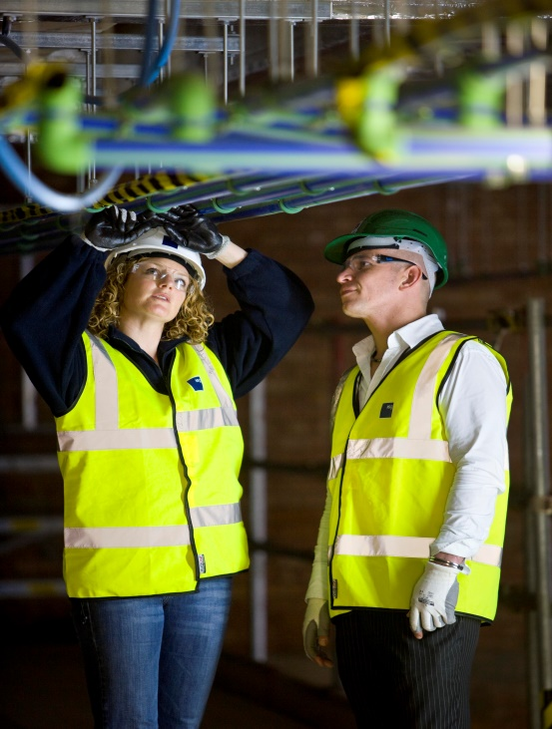
“How do I get into the Construction Industry?”
Apprenticeships
University
Websites and Events
Make sure you check out https://www.youtube.com/user/TheB1MLtd for lots of fantastic videos on construction!
Notes:
How do I get into the Construction Industry?
There are now more routes into construction than ever so we can understand how it can be a bit difficult to know where to start. Here are some examples:
*Animation 1 brings up Apprenticeships*
Apprenticeships:
Apprenticeships are a job with training. You will be employed and will be paid a lower wage to begin with to perform a particular role with an understanding that you will be trained through experiencing the job, as well as studying either at school or college and earning the qualifications to perform your chosen role to a professional standard. Your school or college will teach you the theory, the training provider will teach you the skills to perform these tasks and your employer will allow you to put your theory into practice! At the end of it, you will be a fully paid professional.
*Animation 2 brings up University*
University:
Many roles in construction require you to be qualified to degree level, such as Engineers, Project Managers, Surveyors, Architects and more. Many construction companies offer Higher or Degree apprenticeships which combine working and studying part-time at a university, this can be done on a day-to-day basis or in blocks of time, depending on the programme or requirements of the employer. They can take between three to six years to complete, but once done, you come away with a degree, invaluable work experience and potentially a full-time position.
*Animation 3 brings up Websites and Events*
Websites and Events:
There are also a huge amount of resources online and opportunities throughout the year to learn more about construction.
Go Construct is a massively helpful website. This website showcases the many career opportunities available in construction. It has been funded by the Construction Industry Training Board Levy (or CITB), meaning that the whole industry has contributed to it. It is made by the construction industry, for the construction industry.
Open Doors is an event that happens every year across the country. It offers a unique chance for the public to enter major ‘live’ construction sites, offices, factories and training centres across the UK to see how buildings are constructed and what it’s like to work in the construction industry. Like this presentation, it will show that construction requires a hugely diverse range of skills and professions.
All the information you need is out there – you just need to go and get it!
*Animation 4 brings up Ivor and B1M’s Youtube channel*
Just like Ivor says – make sure you take a look at The B1M Ltd’s YouTube channel, for lots of fantastic videos on construction.

Slide 13
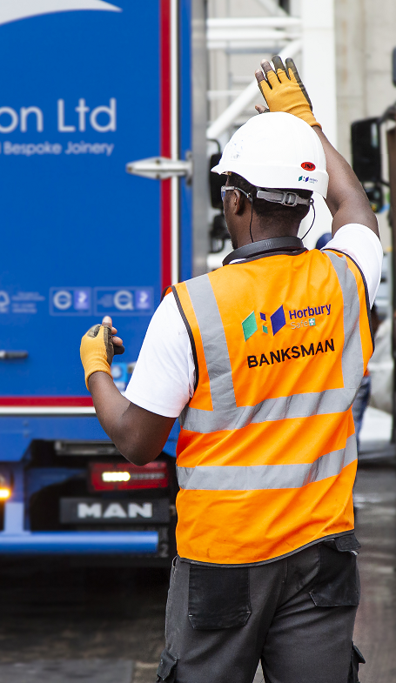
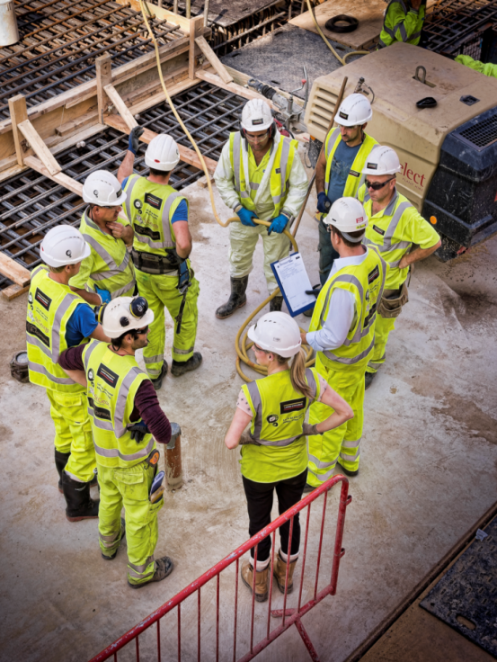
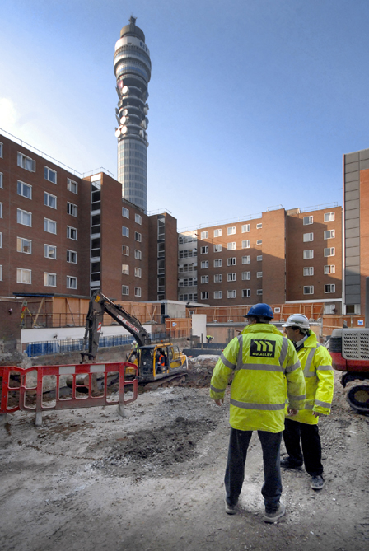
“What skills and attributes do I need to be successful in the Construction Industry?”
A good work ethic
Teamwork
Problem solving
Can you think of any other skills or attributes that you might need to succeed in the construction industry?
Notes:
“What skills and attributes do I need to be successful in the Construction Industry?”
Whether you’re working in construction or any other industry, these are some of the key skills and attributes that will guarantee success at the workplace.
*Animation 1 brings up Good work ethic*
Good work ethic (Ask the audience what they think this is and if they have any examples of it.)
A good work ethic is desired by every employer. They will be relied upon get the job done, be professional at all times and need less overseeing from their superiors. Even things as simple as showing enthusiasm for your work and arriving on time put you in a good place to succeed!
*Animation 2 brings up Work as a team*
Teamwork (Ask the audience what they think this is and if they have any examples of it.)
This one speaks for itself. Very rarely will you work completely alone for your working life, you will rely on others and they will rely on you. An incredibly important skill to have is to be able to work with your colleagues, especially in the construction industry where you could have hundreds of colleagues on site with you every day! You should communicate clearly with them and also listen carefully – it’s a two way street!
*Animation 3 brings up Problem solving*
Problem solving (Ask the audience what they think this is and if they have any examples of it.)
- You will never go through your professional career with everything running smoothly. Being able to assess a situation when things change and fix an unforeseen issue will help you stand out from the rest.
*Animation 4 brings up Honor*
*Ask the audience what they think are good skills and attributes.*

Slide 14
“Is a job in construction fulfilling, competitive and exciting?”
We hope you think about a career in construction in the future!
Thank you for listening to our presentation!
Notes:
“Is a job in construction fulfilling, competitive and exciting?”
Ask the audience if they agree or disagree with the statement.
Thumbs up agree
Thumbs down disagree
*Animation 1 brings up the tick*
Thumbs up are correct!
*Animation 2 and 3 brings up Ivor, Honor and their messages*
Honor: Thank you for listening to our presentation!
Ivor: We hope you think about a career in construction in the future!

