Slide 1
An Island wide Skills Service
Notes:
Please print off worksheets to accompany this PowerPoint. Worksheet 3 could be used as an extension.

Slide 2
Worlds most
unusual jobs
Unbelievable
Really weird
Amazing
Notes:
Use these 8 unusual jobs to facilitate discussion around the skills and areas of learning required to do them.

Slide 3
You will see some images pop up.
Try to guess what the unusual jobs are.
Use the worksheet to
fill in your answers.
Notes:
Students will be shown an image and have to guess the job role. Next click will bring up the job.

Slide 4
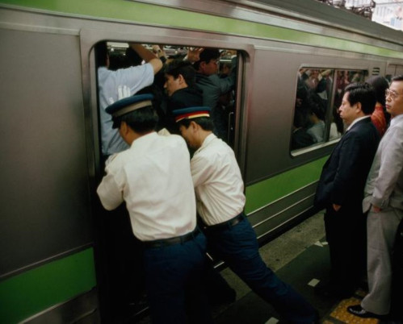
1.
Train Pusher
On the trains in Japan
‘Oshiyas’ are hired to help cram as many people onto a train as possible by pushing them from the outside until the doors will close.
Notes:
Train Pusher Japan known as Oshiyas.

Slide 5
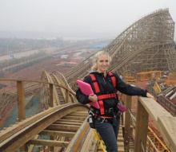
2.
Roller Coaster
Engineer.
Anya Lehrner spends her time making up technical drawings of roller coaster trains and parts. She makes sure that the roller coaster parts work correctly and then gets to be the first to test them out!
Notes:
Roller coaster engineer.

Slide 6
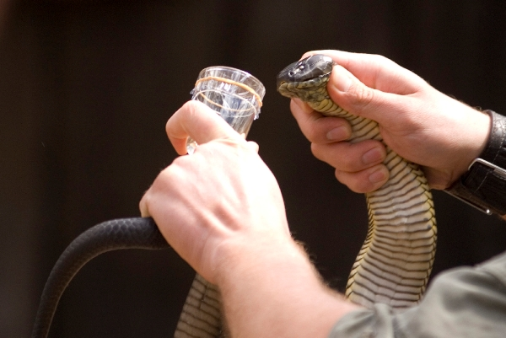
3.
Snake milker
The job of the snake milker is to collect the venom of poisonous snakes in jars. This is for use in anti-venoms and other medicine.
Notes:
Snake milker

Slide 7
4.
Full time Netflix viewer.
Imagine being paid to watch TV all day! Netflix has hired someone to watch all of their programs before it is available to the public and give it a correct tag.
Notes:
Fulltime Netflix viewer

Slide 8
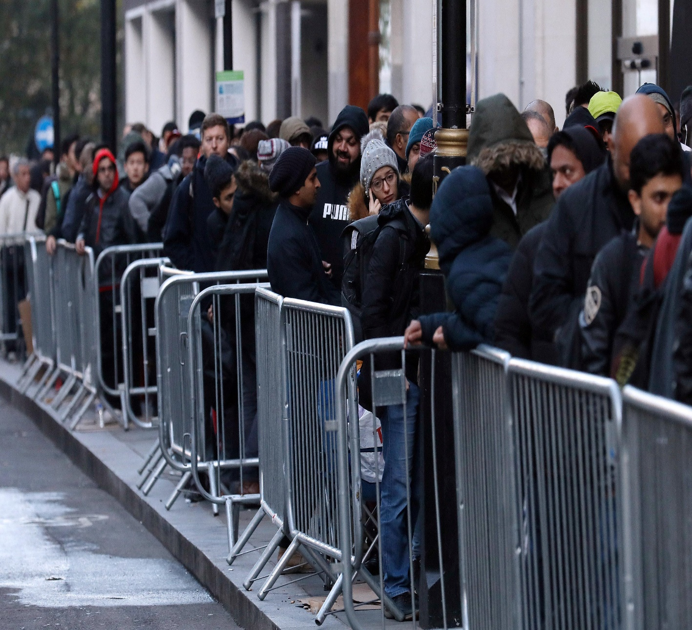
5.
Professional queuer.
People are now paying money for professional queuers to wait in line for them. One man got so much business that he has started his own company in the USA.
Notes:
Professional queuer.

Slide 9
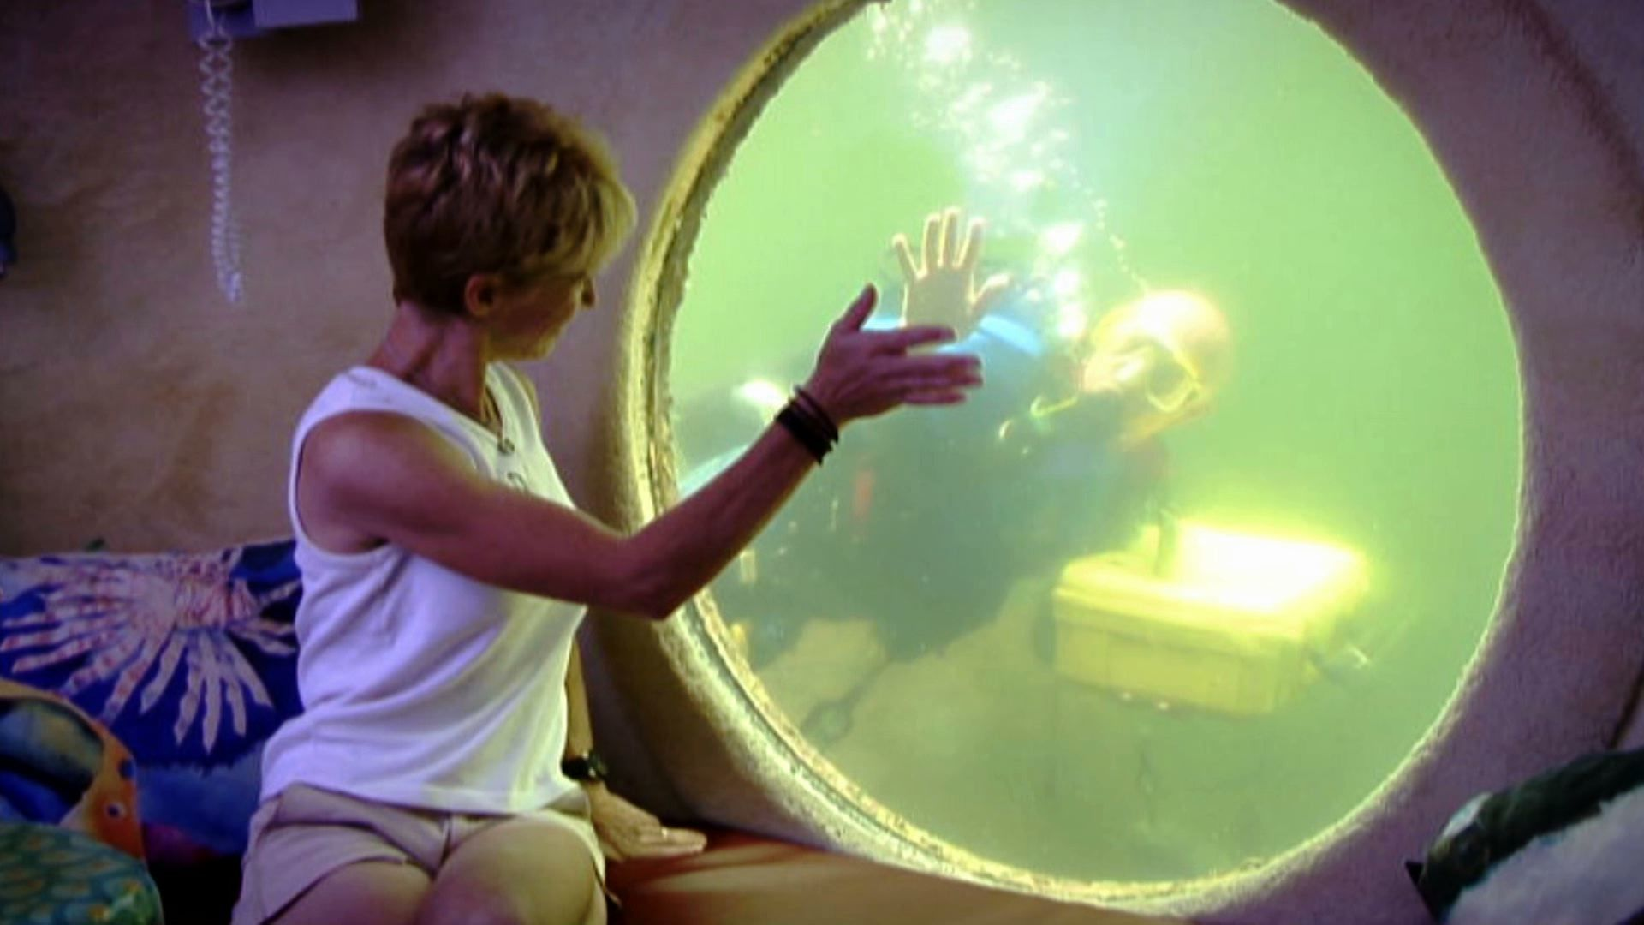
6..
Underwater Pizza Delivery
Person.
An underwater hotel in Florida employs a pizza delivery driver to deliver PIZZA! Lets hope it doesn’t get soggy!
Notes:
Underwater pizza delivery person

Slide 10
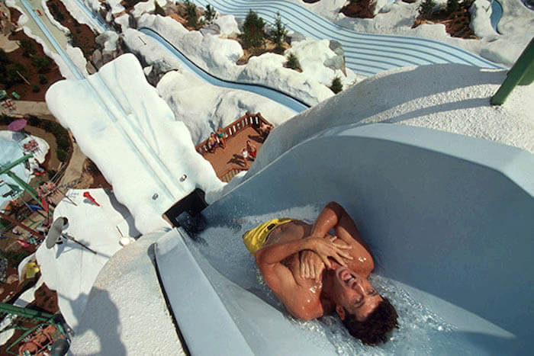
7.
Water Slide tester.
A travel company put out a job advert ‘to be mad about water parks,’ ‘willing to travel,’ ‘comfortable in swim wear’ and ‘happy to get wet at work.’ Looking for someone to test their waterslides all over the world.
Notes:
Water slide tester

Slide 11
8..
Professional sleeper.
NASA hires professional sleepers. They are given the task of having to sleep for days on end.
Notes:
Professional sleeper.

Slide 12
449440
gov.je/skillsjersey
skillsjersey@gov.je
CONTACT US
skillsjersey
skills_jersey

Slide 13
An Island wide Skills Service

